Slide 1
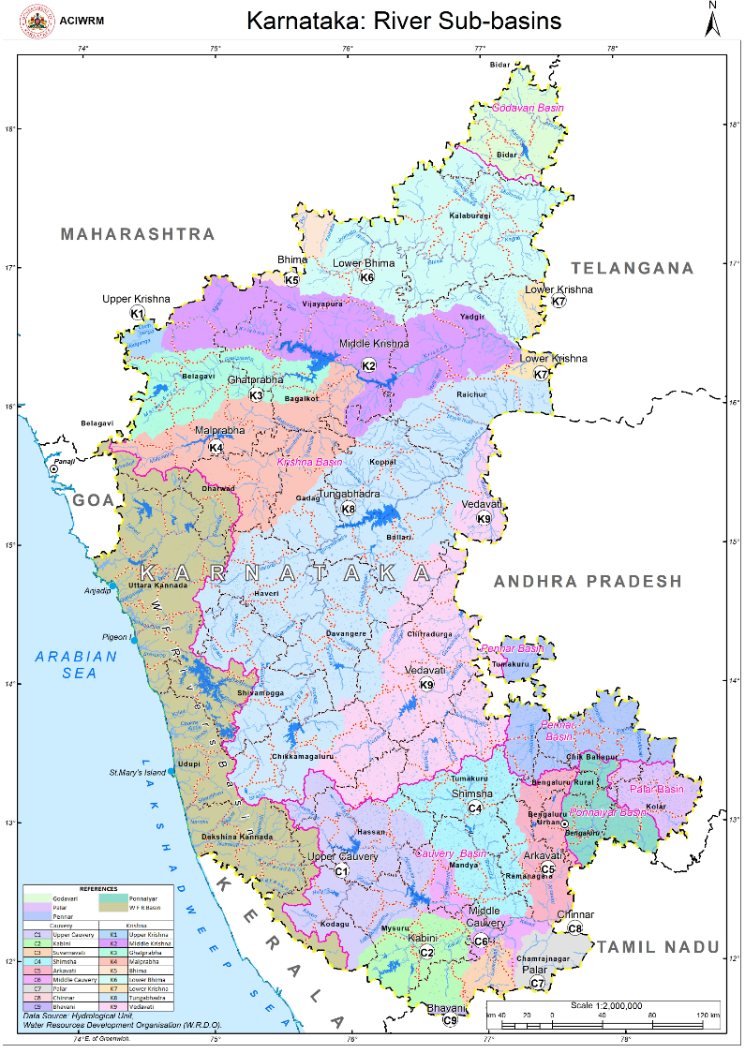
Karnataka Water Resources Information System
(KWRIS)
June 18, 2022
ACIWRM

Slide 2
NEED FOR KWRIS
No single window information on water resources information of the state
Water resources data collected, generated remains with different departments to be made accessible to all users
Spatial, Analytical and Statistical dashboards to different stakeholders
Public access to reliable information on water resources of the State

Slide 3
KWRIS ROADMAP

Slide 4
KWRIS Phase - 1
Providing a data repository for water related data
    Identify resources across the state
    Import all data on a regular basis from various sources, with a basic level of validation
    Provide the basis of a data availability catalogue
Statistical and Analytical dashboards
Spatial data linkage
Stakeholder forums

Slide 5
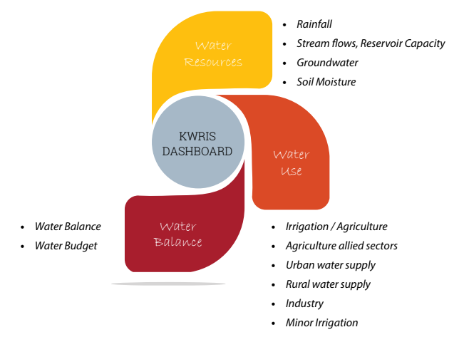
Phase - 1
Water
Resources
Water
Utilisation
Water
Balances

Slide 6

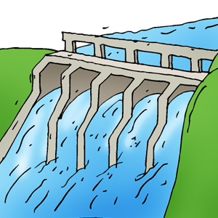
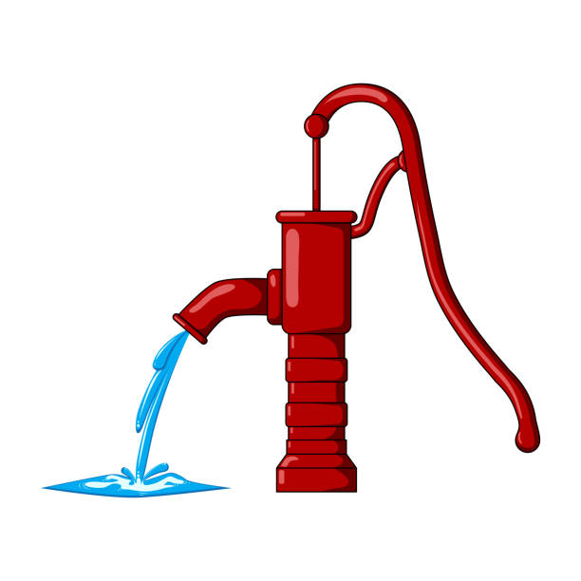
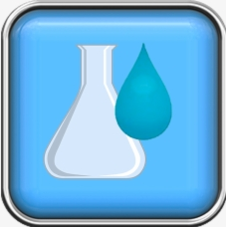
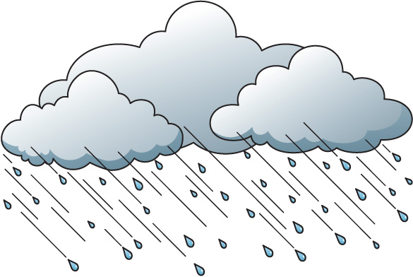

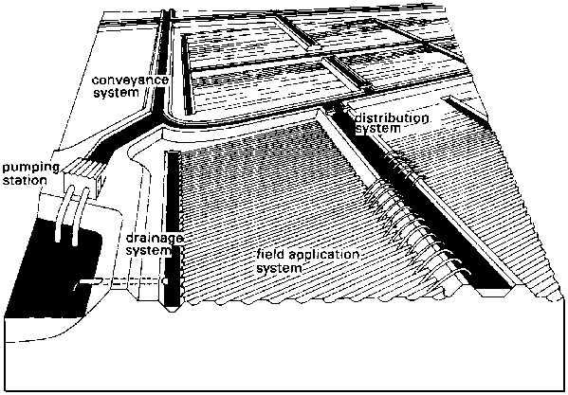
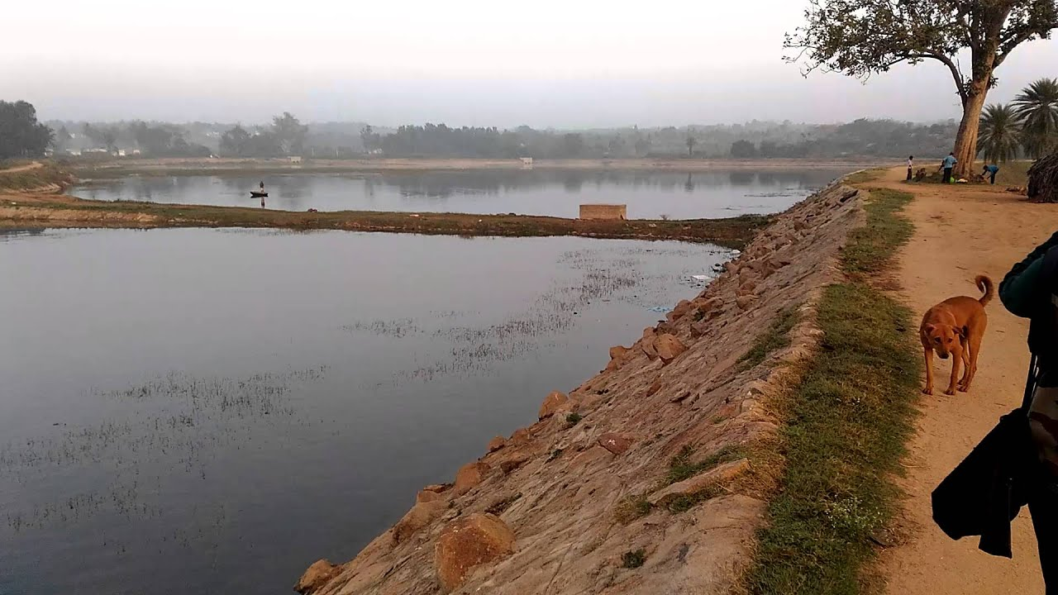
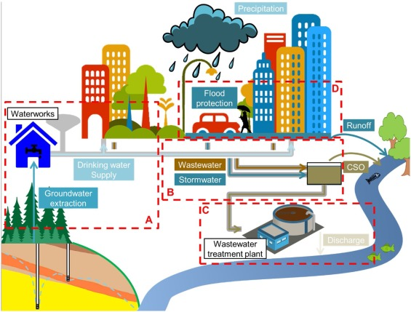
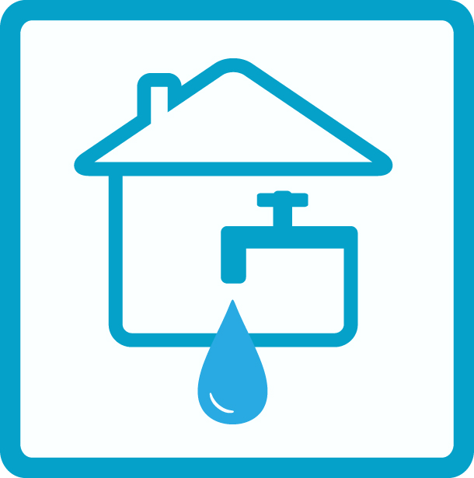
Water Resources Available
1986 -2021
1991-2020
1986 -2021
1986-2020
1986-2018
WRD
WRD
WRD
GWD
PCB
Rainfall and Weather
Stream Gauge
Reservoir
Ground Water
Water Quality
Hourly, Daily, Twice Daily
Daily
Daily
Daily
1071 Stations 5,34,030 Records
44 Stations
9751 Records
13 Locations 68,174 Records
2347 Locations
1,71,873 Records
46 Locations
1496 Records
ahead
Available
Demand
data
users
DSS
timeline
about
Water Balance
Water Utilisation
2021
2009 -2018
2016-2018
2011-2018
1990-2018
WRD
MI
KMDS
NRDWP
Urban Water
DES
Canal
Minor Irrigation
Rural Water
Agriculture
Hourly
Annual
Annual
Annual
Annual
1 Project
39 Locations
Locations
12,519 Records
Locations
810 Records
Locations
240 Records
Locations
1,14,210 Records

Slide 7
How KWRIS support Departments?
Planning and investigation of major and medium irrigation projects
Quick Information regarding Inter-state water observations and analysis
Data bank of all hydrological data of the State and providing information regarding completed, ongoing and proposed irrigation projects of the State
Preparing catchment area maps, digital maps of all hydro meteorological stations of the State (Consolidate different finished and ongoing project outputs at one place e.g. Hydrology Project Phase I, II and III)

Slide 8
How KWRIS support Departments?
Command area maps of completed, ongoing and proposed irrigation projects
Support CADA activities and Water User Cooperative Societies
Support NIGAM’s canal automation “Online Water Delivery, Planning, Monitoring and Decision Support System for Canal Operation”, water delivery schedules, actual delivery and deviations using SMS and web-based software
Assessment of groundwater resources in the State, periodic monitoring of groundwater level in the State, monitoring of groundwater quality, selection of sites and construction of artificial recharge structures, support regulation of groundwater resources in a systematic and scientific manner

Slide 9
How KWRIS support Departments?
Line departments, zilla panchayats and other government institutions, universities and colleges, non govt. organizations, public sector and private sector institutions
Carrying out customized projects and by providing consultancy services and raw data / processed products
Satellite data base maps, thematic maps, action plans, attribute data, and geo-data bases.
Classification, tabulation, analysis and presentation of data on various socio-economic aspects of the State and Centrally sponsored programmes and dissemination of information e.g DES data and Agriculture Crop Survey data

Slide 10
How KWRIS support Departments?
Estimation of consumptive water use – evapotranspiration, Season wise irrigated areas and crop pattern
Easy access of CWC, CGWB, IMD datasets
Timely, rigorous and useful data analysis for decision support

Slide 11
KWRIS achievements
Data from various departments populated (atleast last 30 years period)
Water Atlas – Karnataka, Tungabhadra and Ghataprabha sub-basins
Publications and Brochure – KWRIS Manual and Overview
Water Accounting and Support to Water Productivity – K8 & K9, K2, K3 and K4
Support to Thematic Trainings – Basic, Advanced and Google Earth Engine
Support to River Basin Profile and Planning
Support to Hydro-meterological station rationalisation – Station codes to TIDEDA

Slide 12
KWRIS achievements
Assessed by an expert group, comprising experts from Indian Institute of Science (IISc), Karnataka State Council for Science & Technology (KSCST), Visveswaraya Technological university (VTU), Dept of Water Resources and other departments
Was installed on the ACIWRM server, and Phase II requirements were identified
KWRIS was hosted in State Data Centre (SDC) of Department of e-Governance after a Security audit and the portal domain name is https://water.Karnataka.gov.in

Slide 13






Groundwater module
Remote sensing module
Static and dynamic data, Well details, Block /Watershed GW categorization, Water quality etc and Report generation
Soil moisture maps, Drought monitoring, Water productivity etc
Surface water module
Water User Association module
ahead
Online catchment delineation, yield estimation, water body extent estimate, canal operation monitoring, stream flow simulations etc
history
users
DSS
timeline
about
WUA Profile data entry, WUA benchmarking
Land and water management module
Mobile survey module
GP Water budgeting, FES-CLART integration, Watershed management etc
Survey tool for field data collection of Reservoirs, tanks, WUAs etc

Slide 14
KWRIS Stakeholder Data Uses
KWRIS
Data collection / Monitoring
Data archival / retrieval
Data validation, viewing
Data analysis/ Report generation / sharing

Slide 15
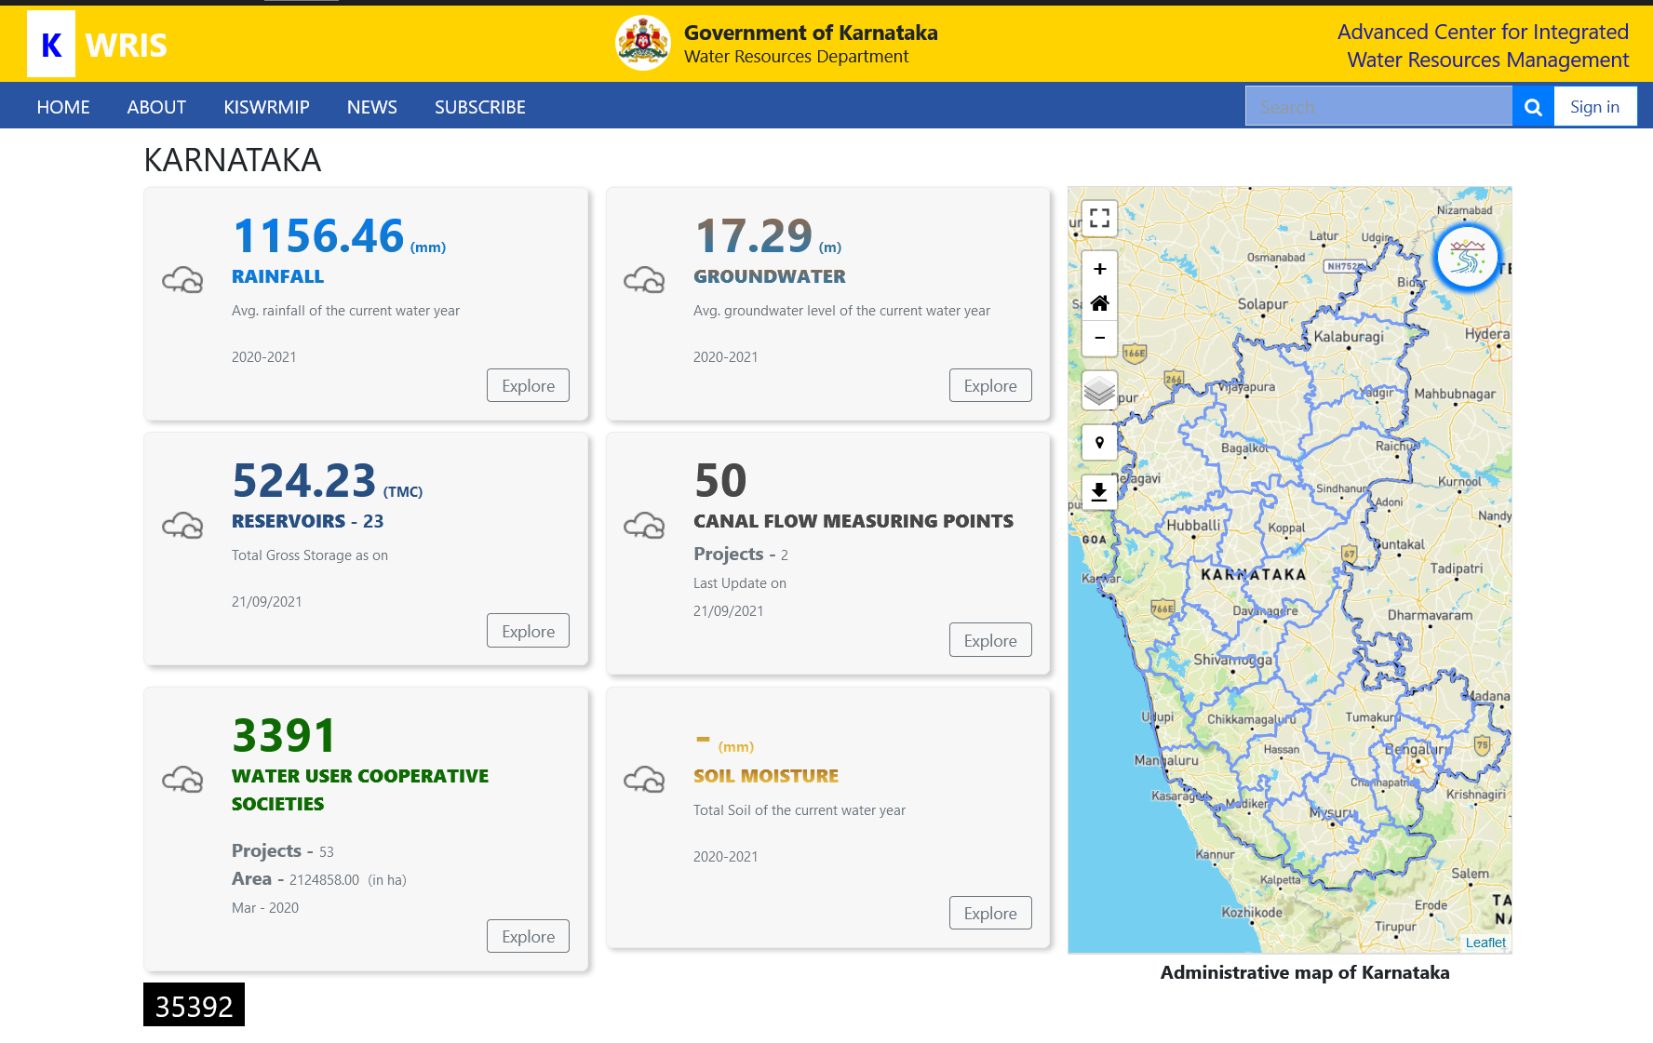

Slide 16
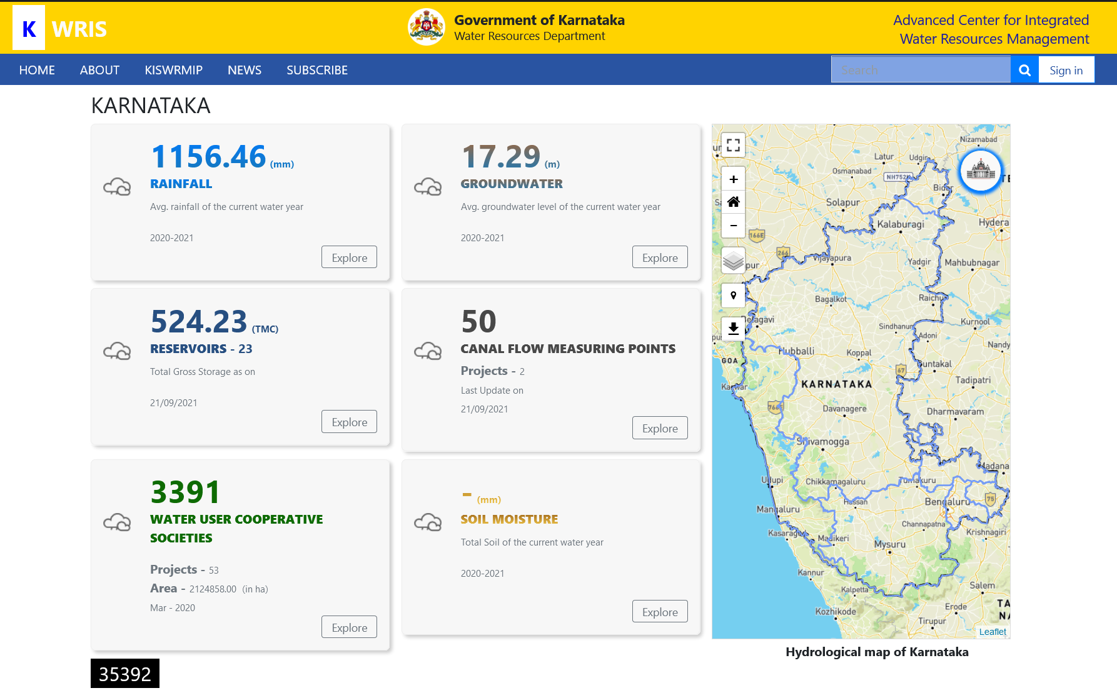

Slide 17
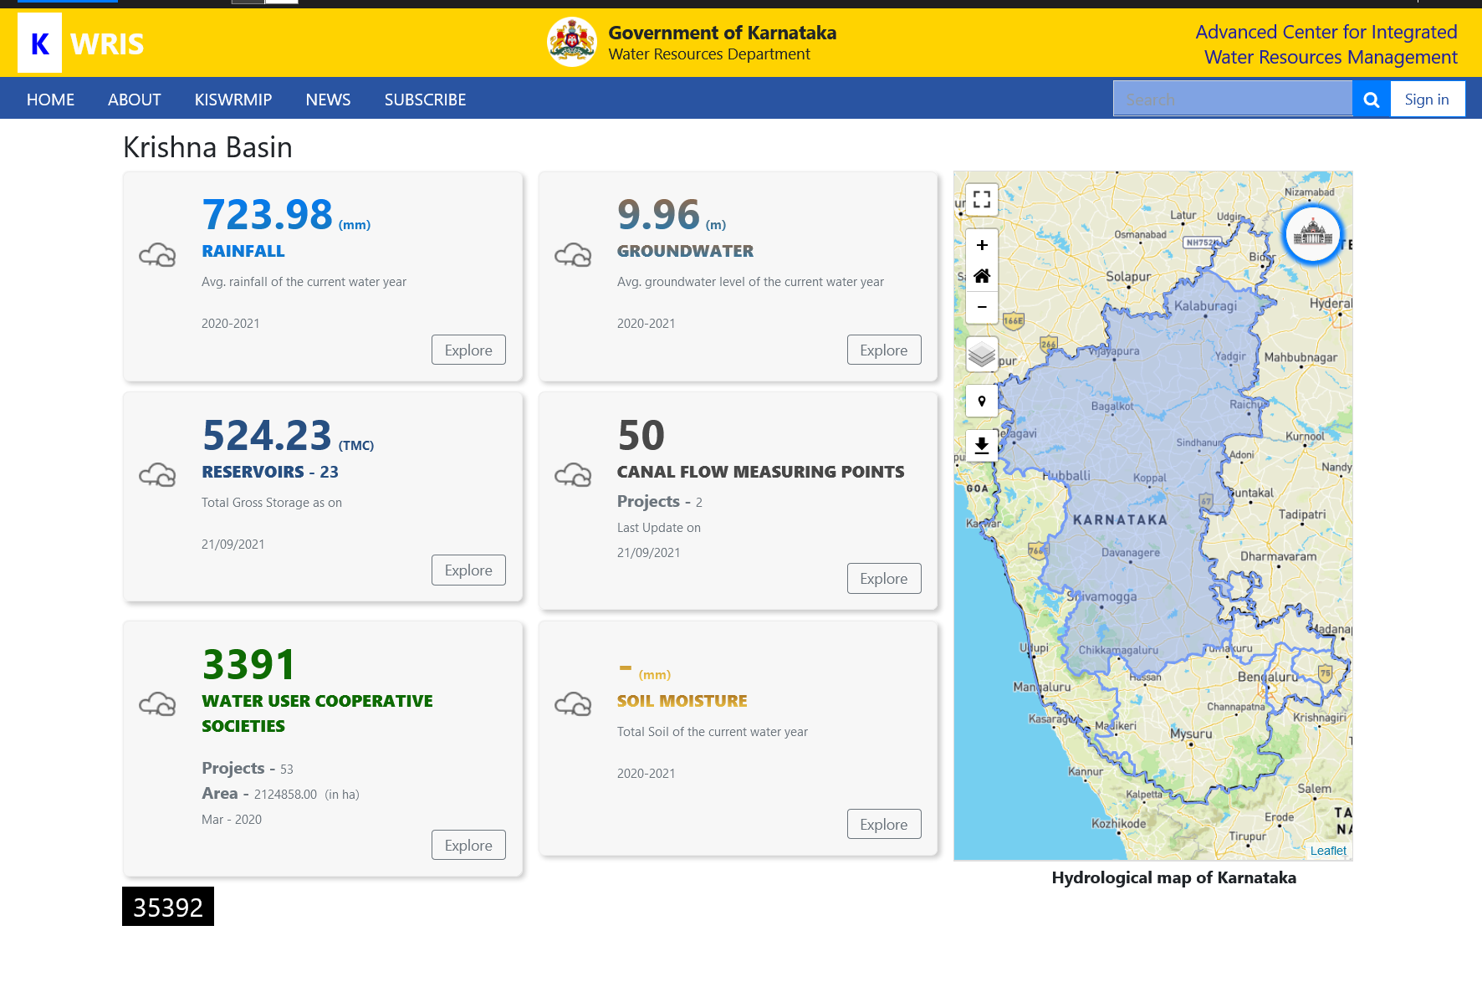

Slide 18
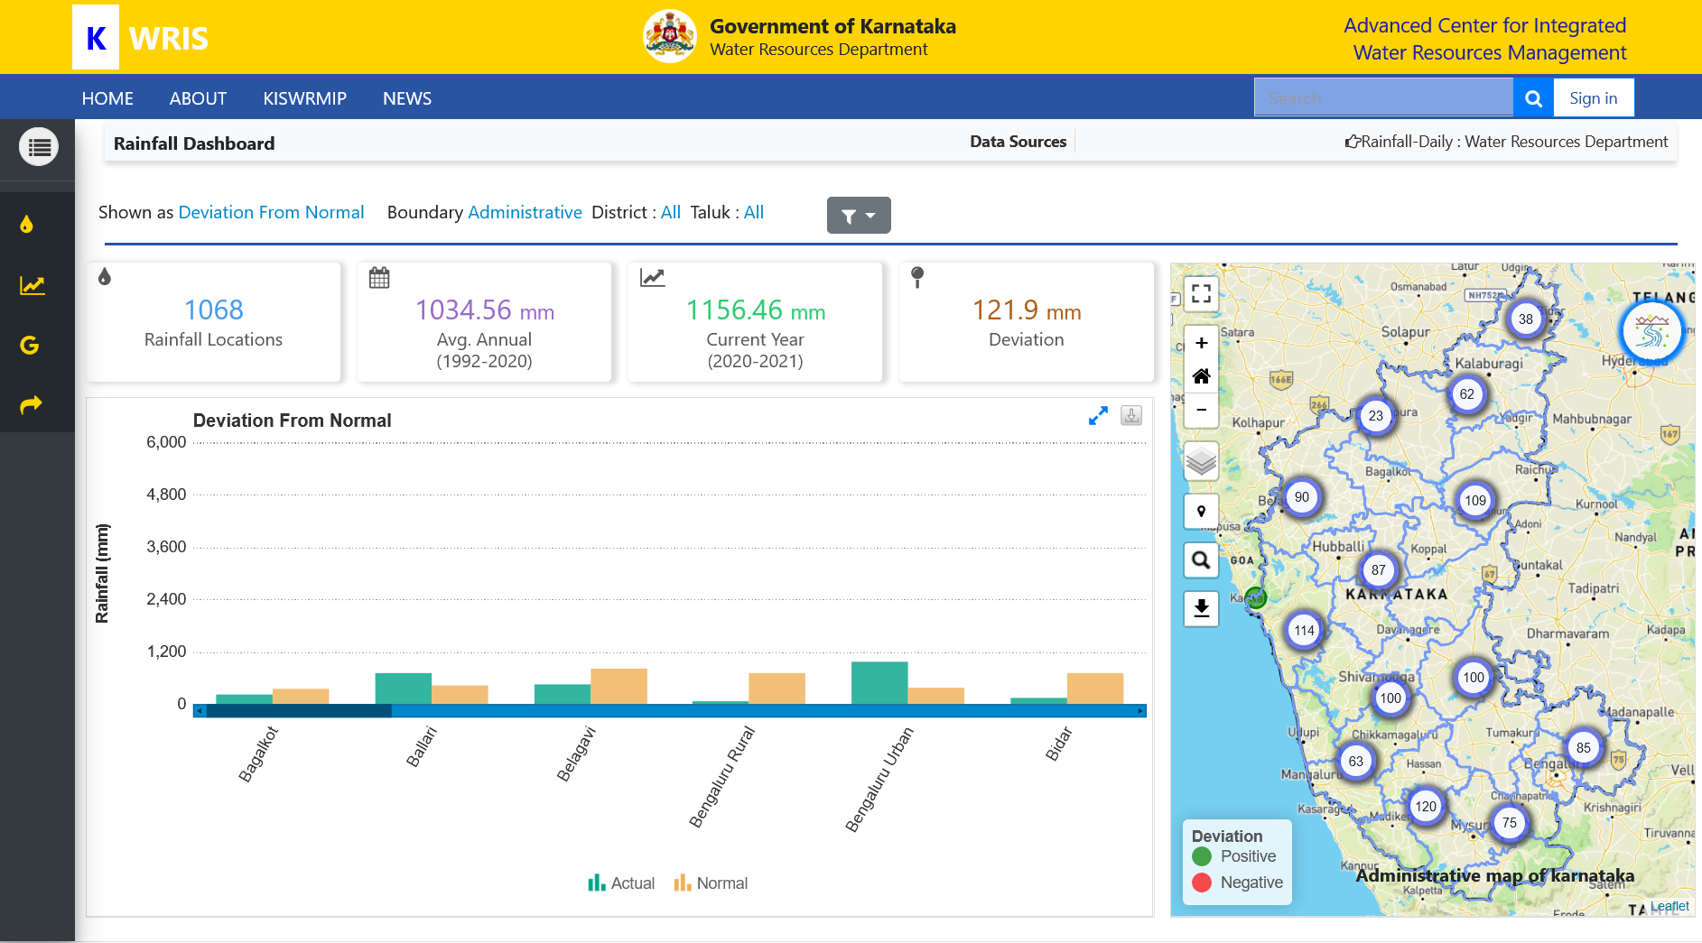

Slide 19
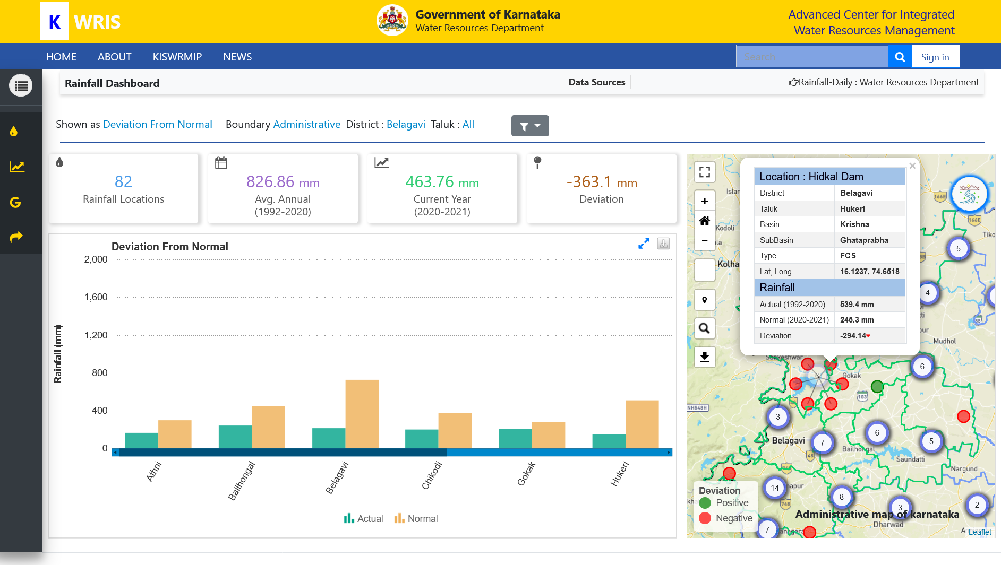

Slide 20
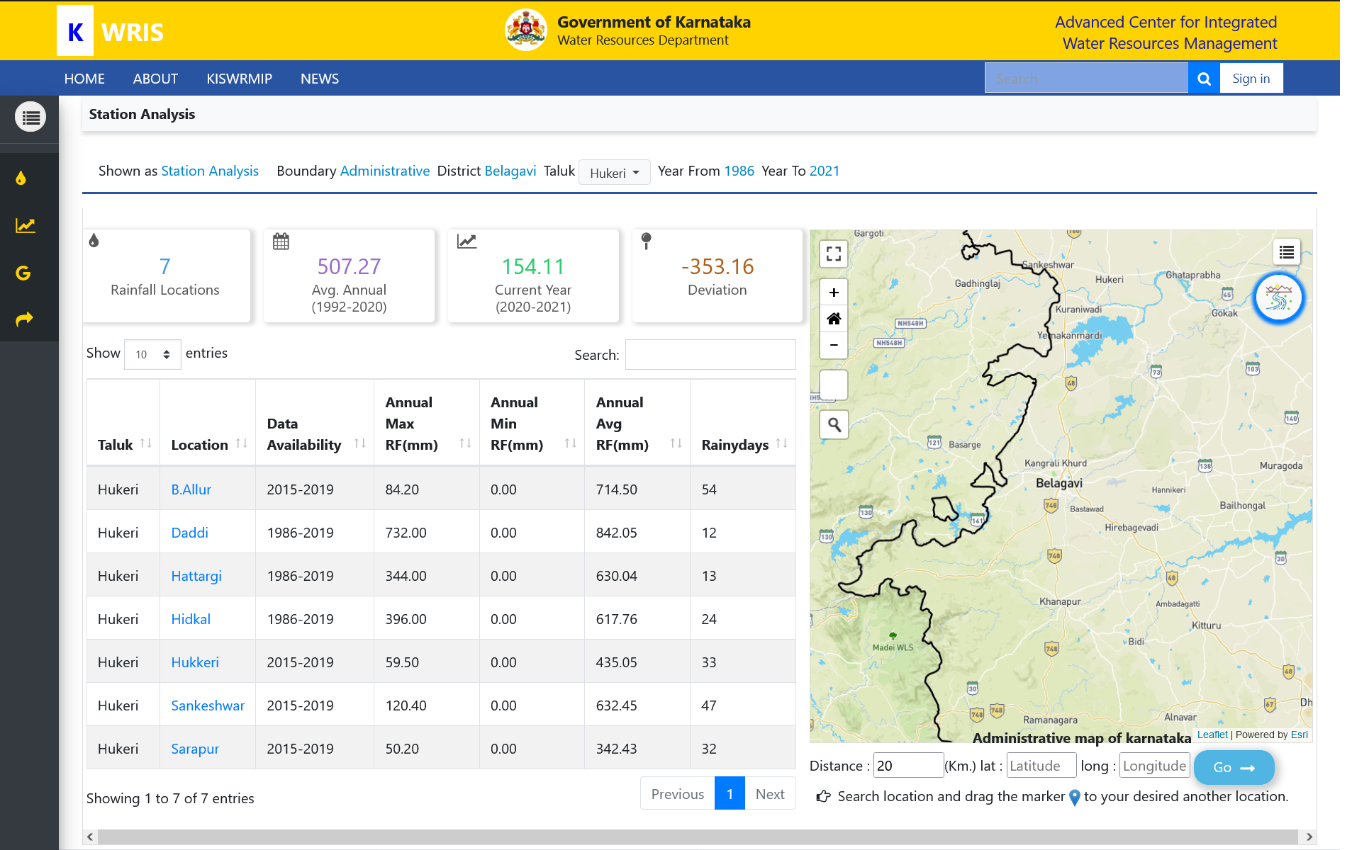

Slide 21
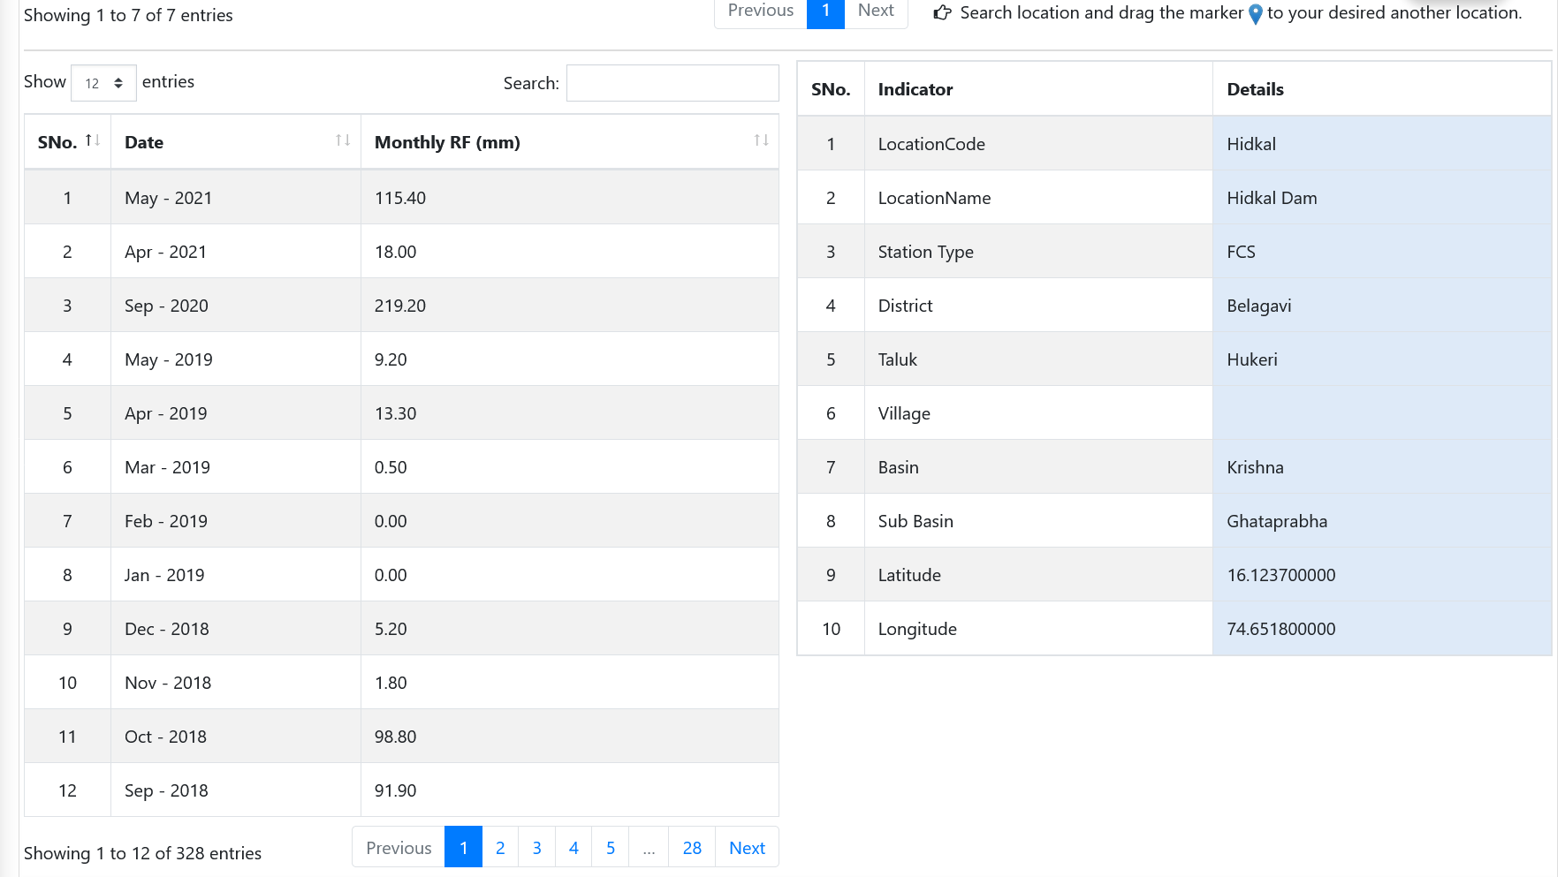

Slide 22
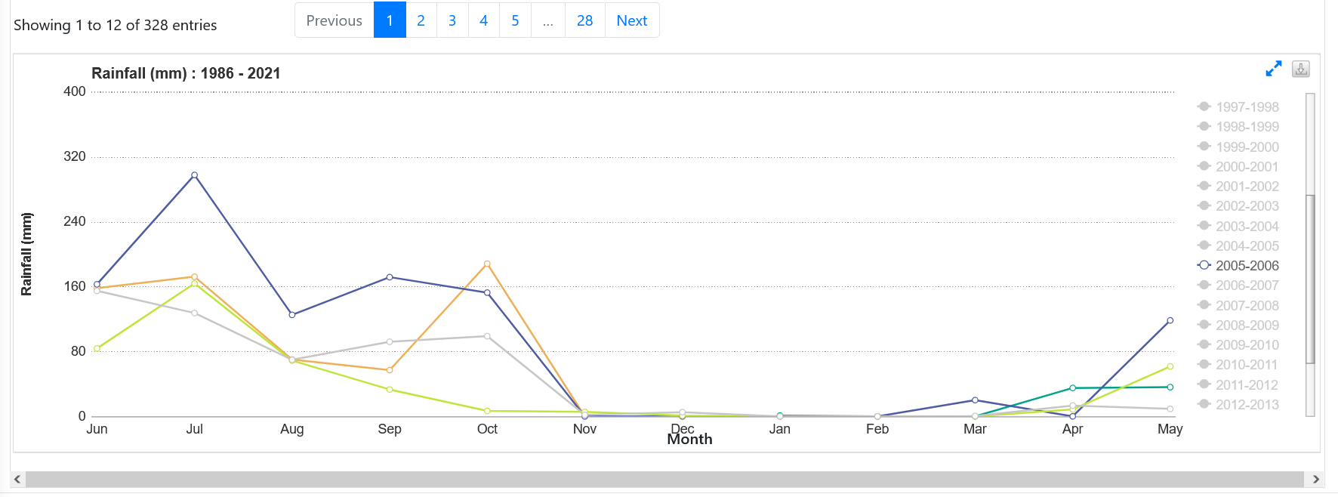

Slide 23
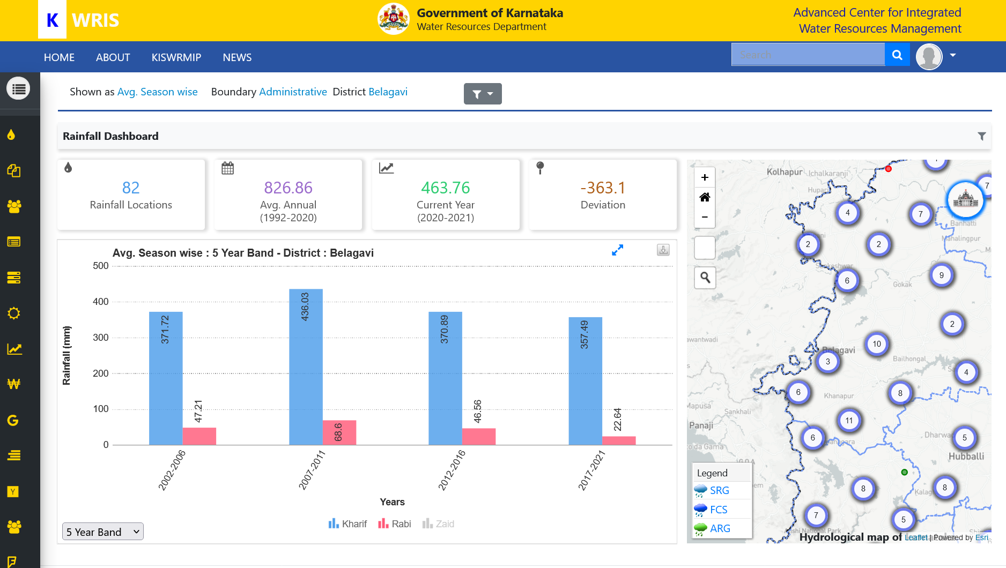

Slide 24
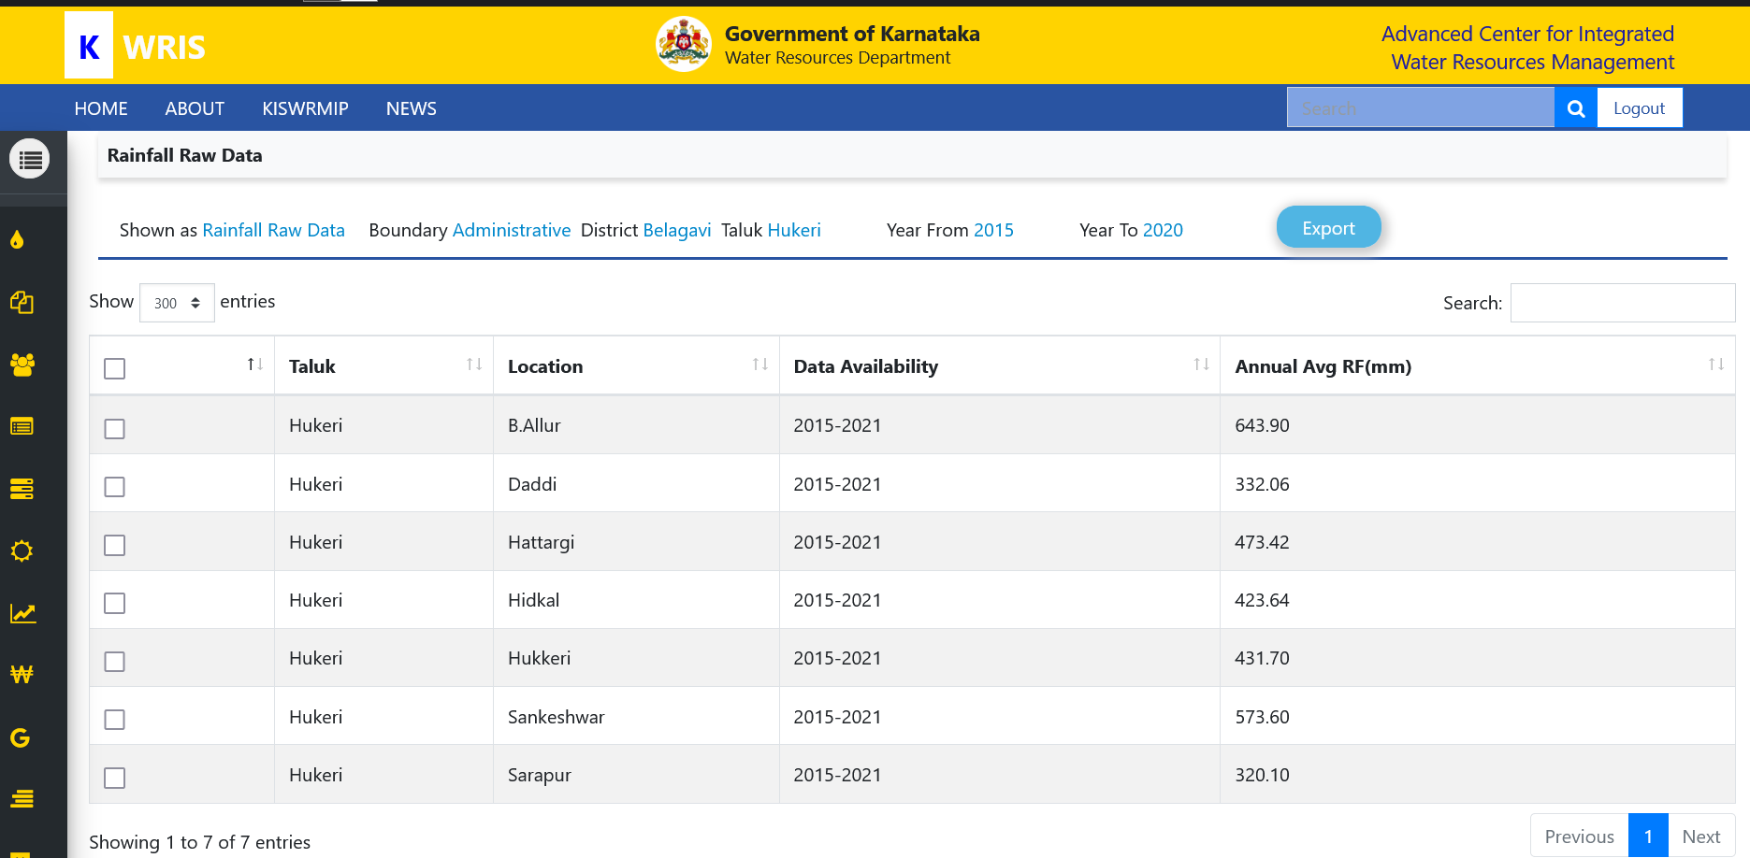

Slide 25
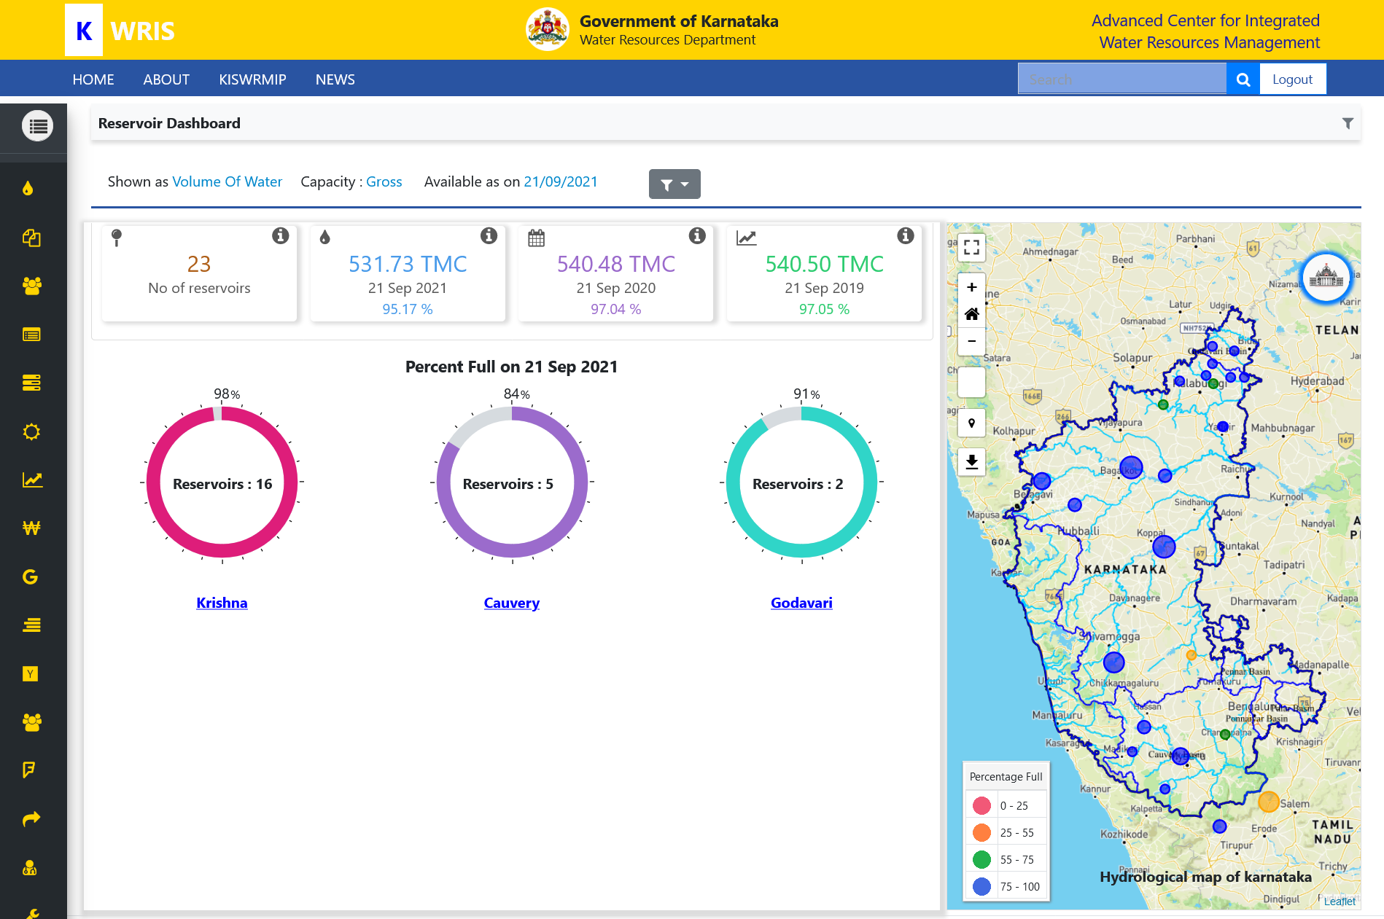

Slide 26
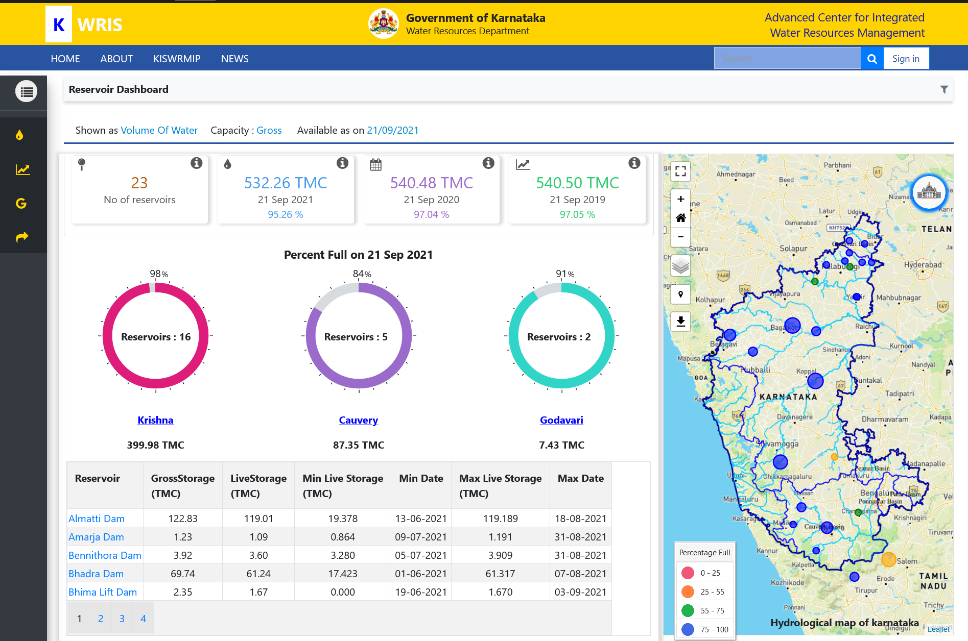

Slide 27
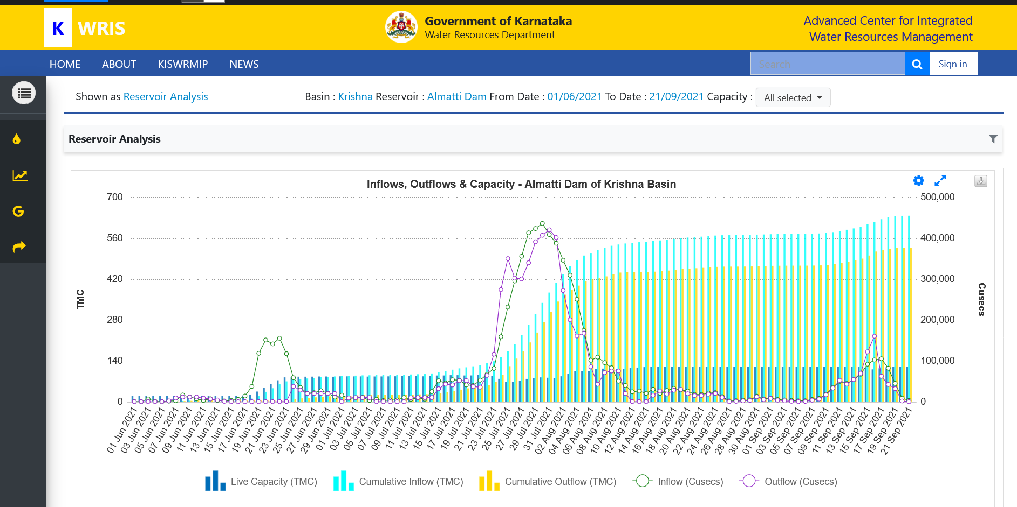

Slide 28
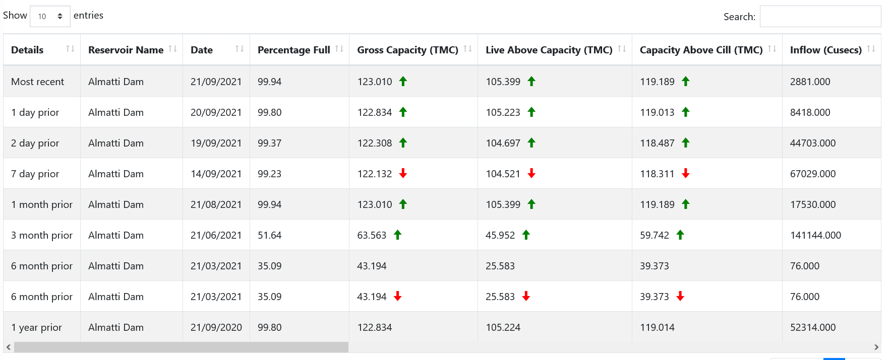

Slide 29
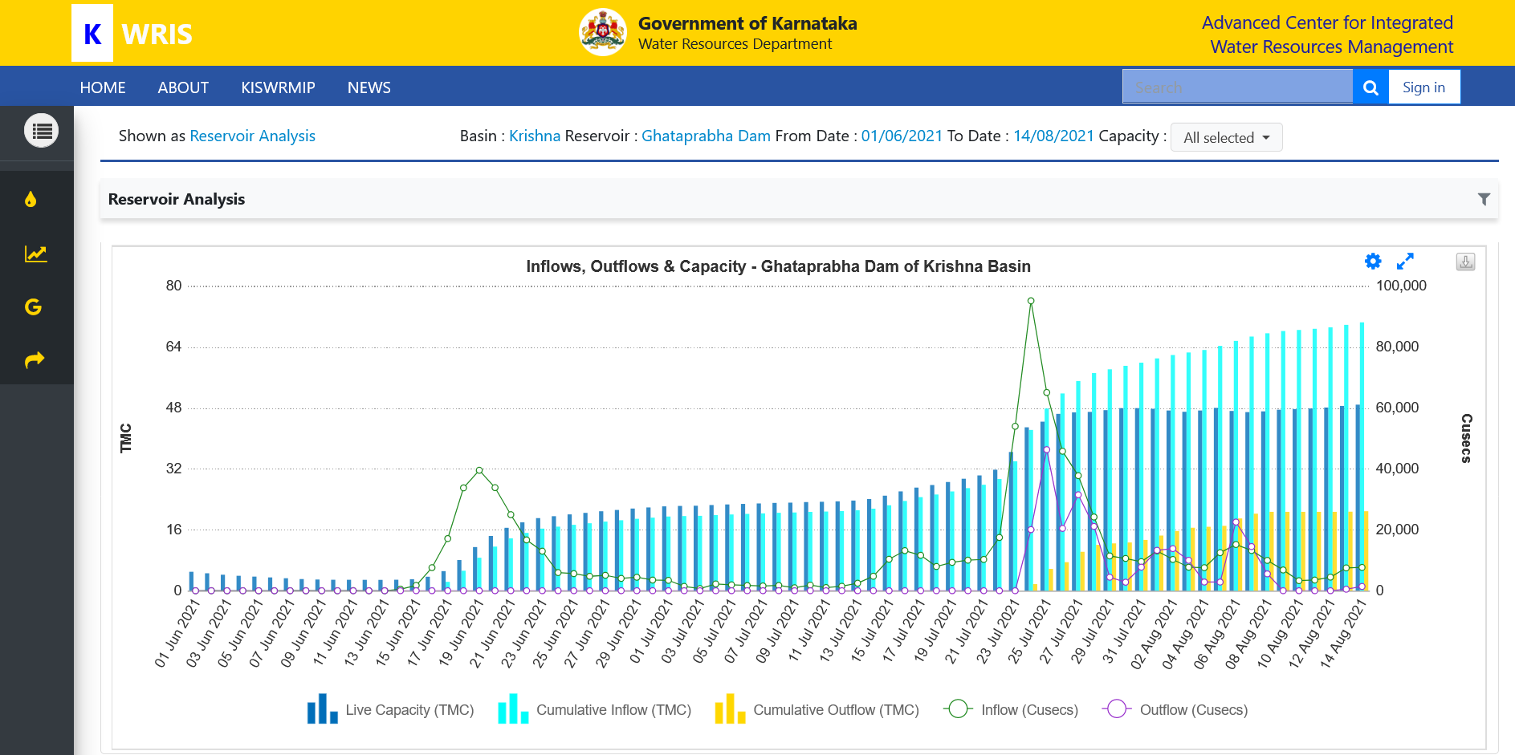

Slide 30
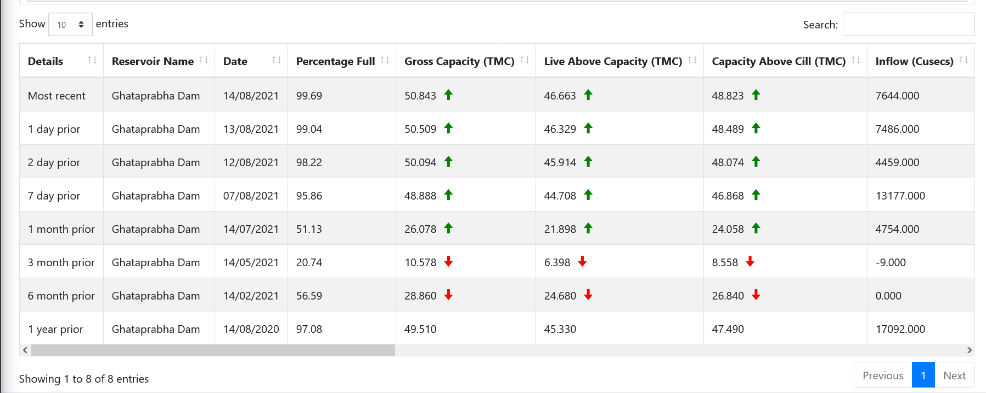

Slide 31
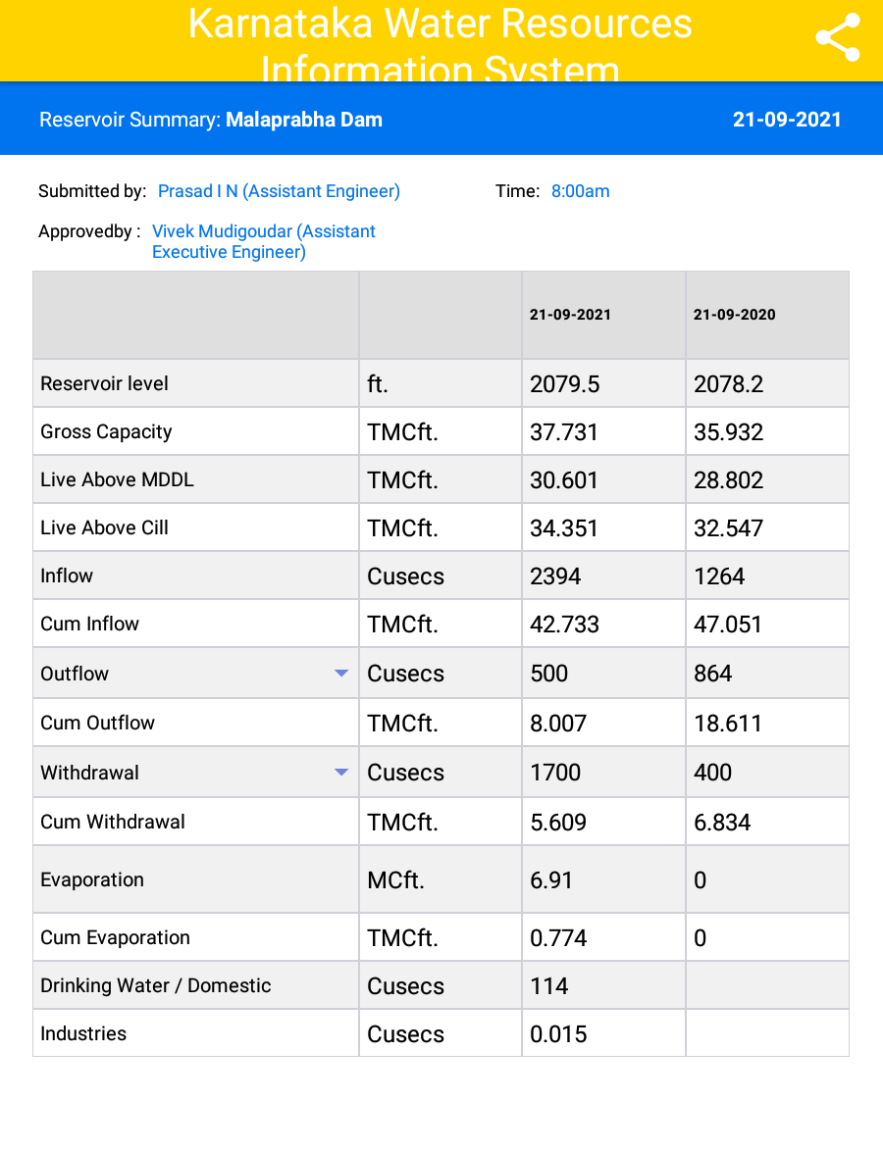

Slide 32
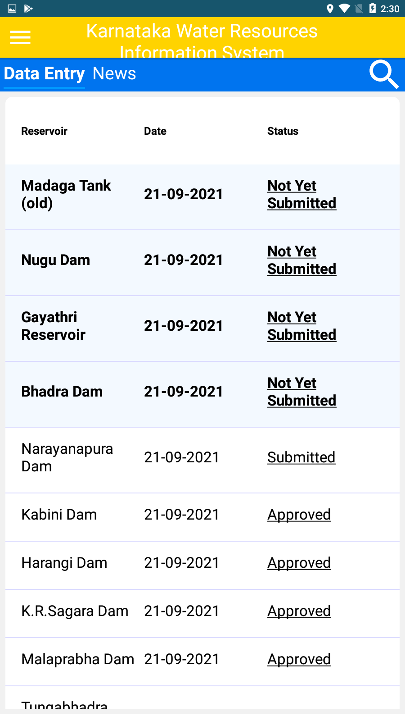

Slide 33
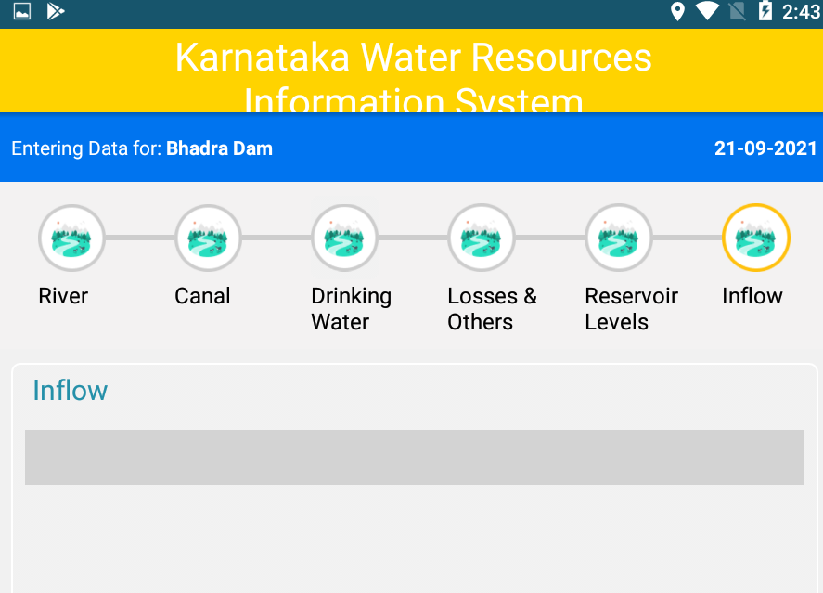

Slide 34
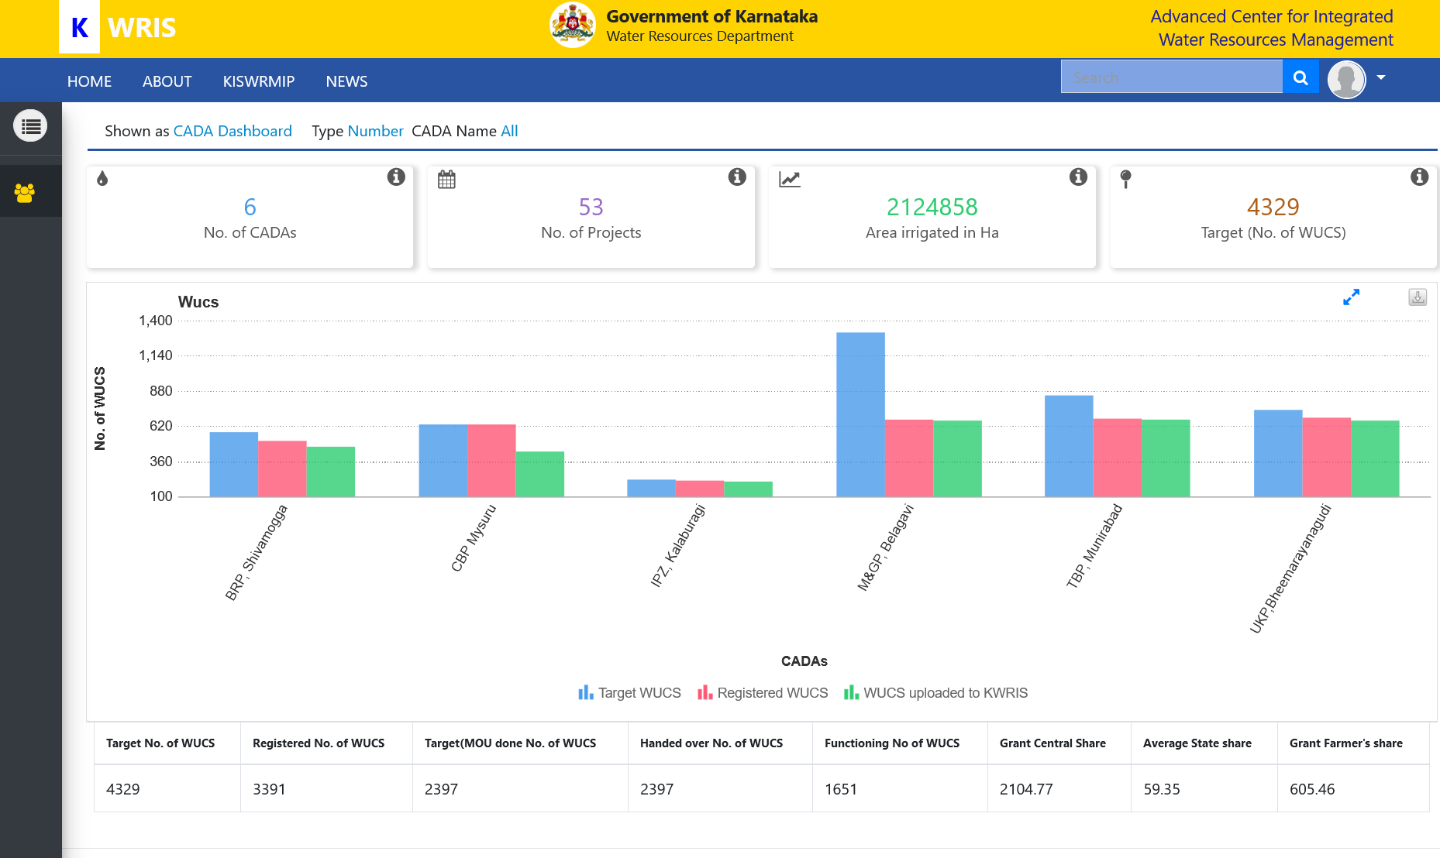

Slide 35
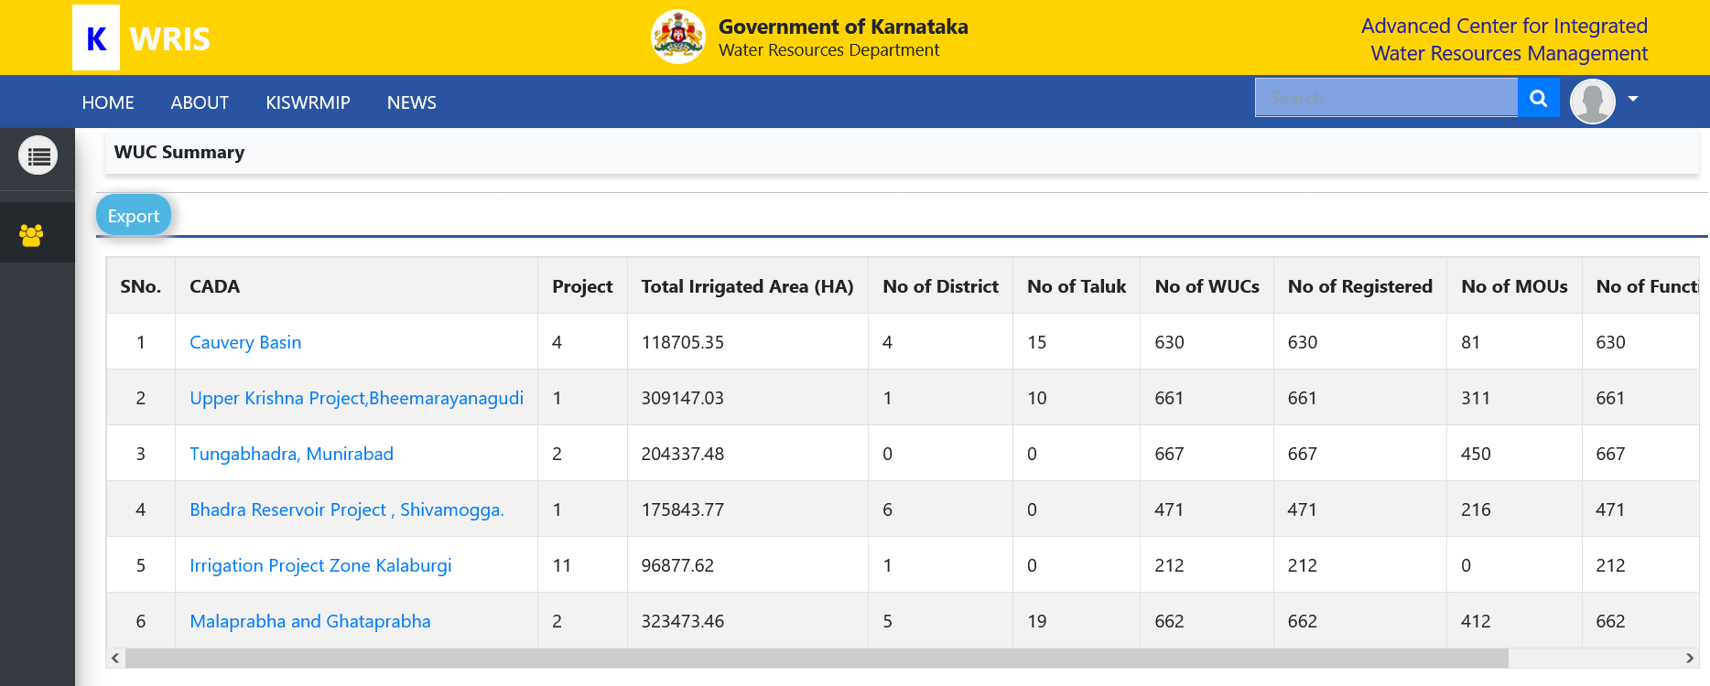

Slide 36
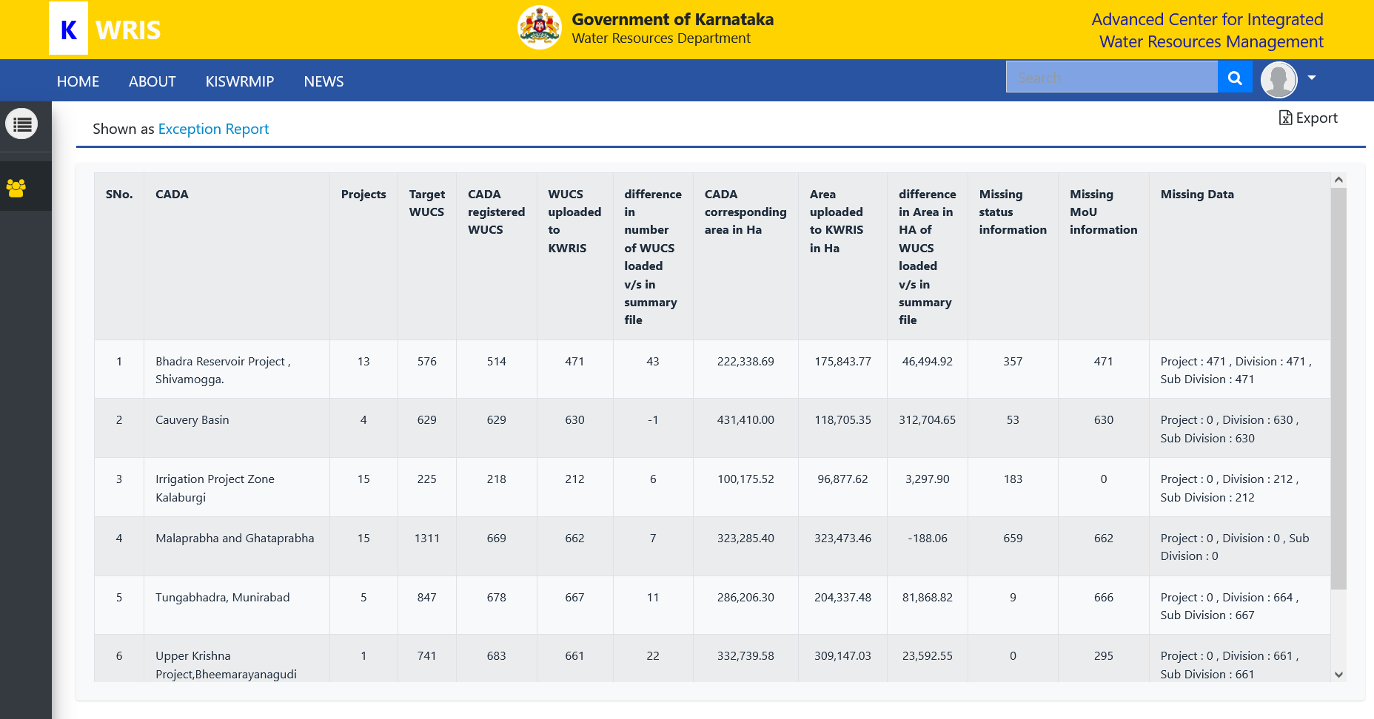

Slide 37
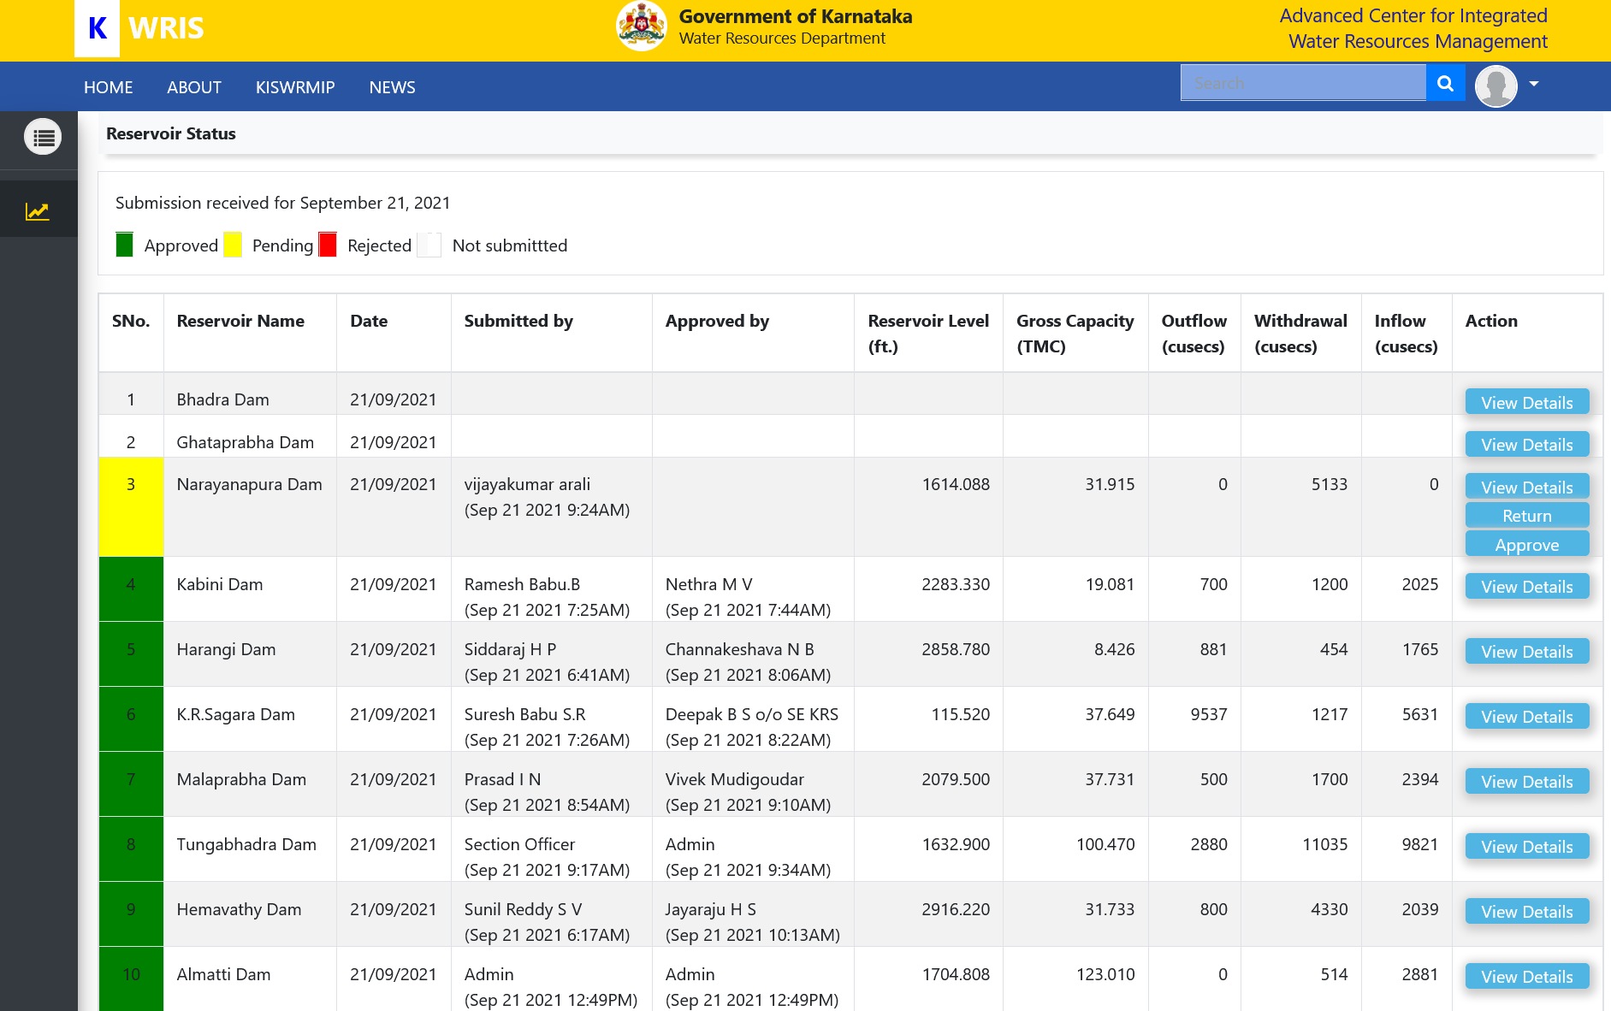

Slide 38
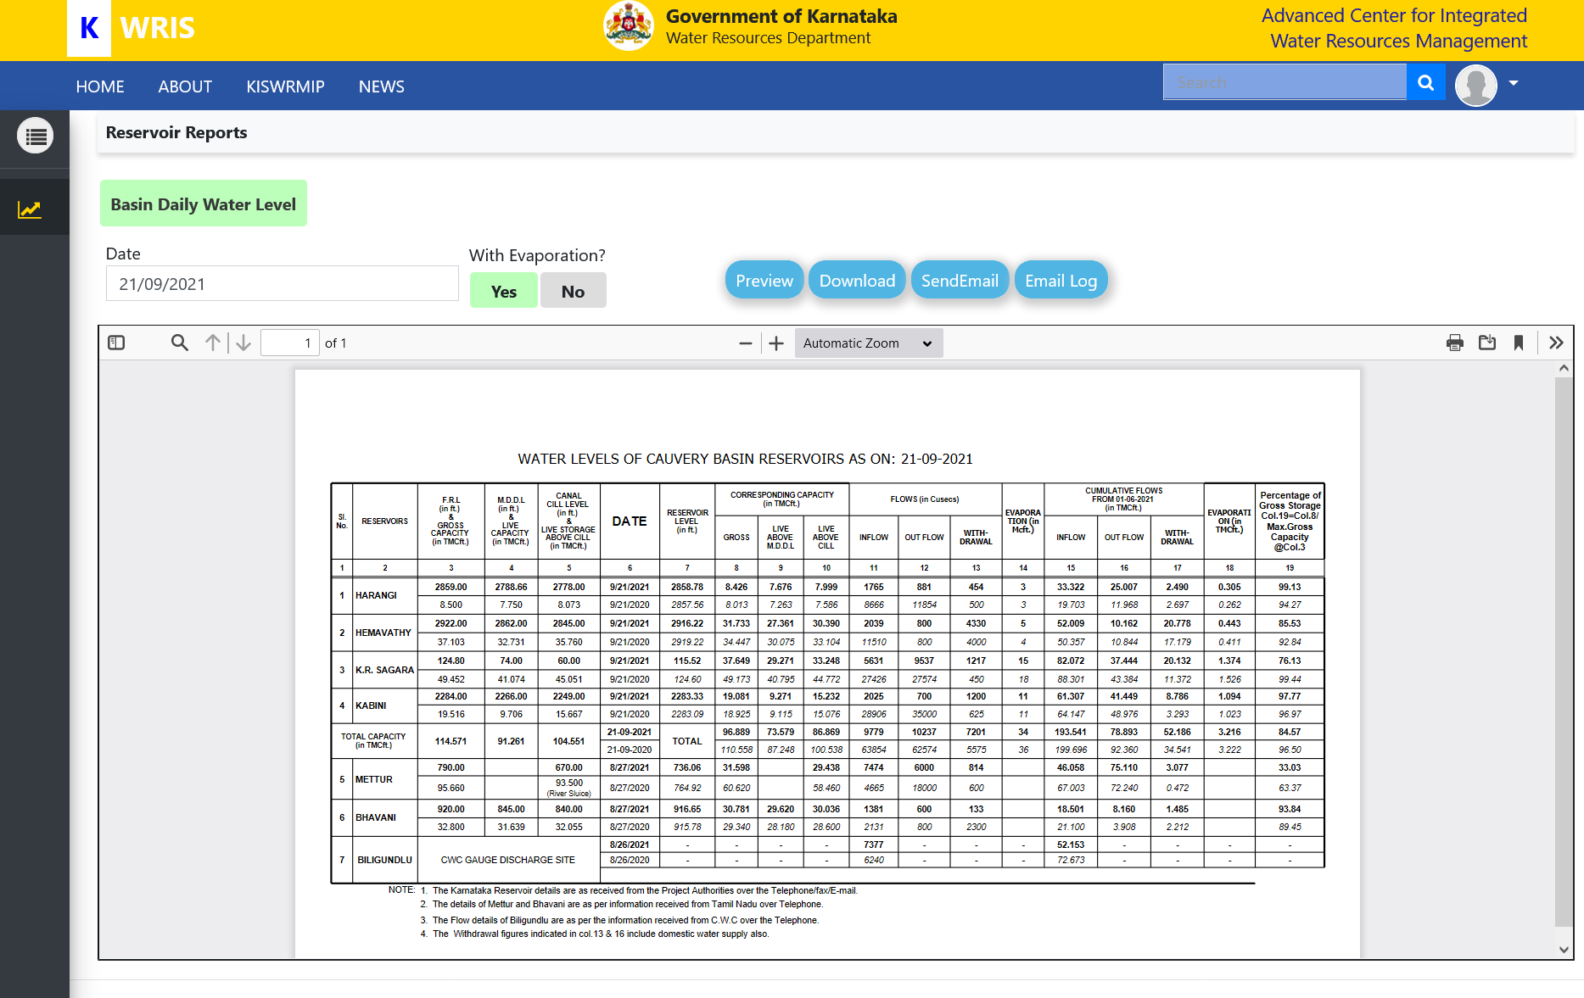

Slide 39
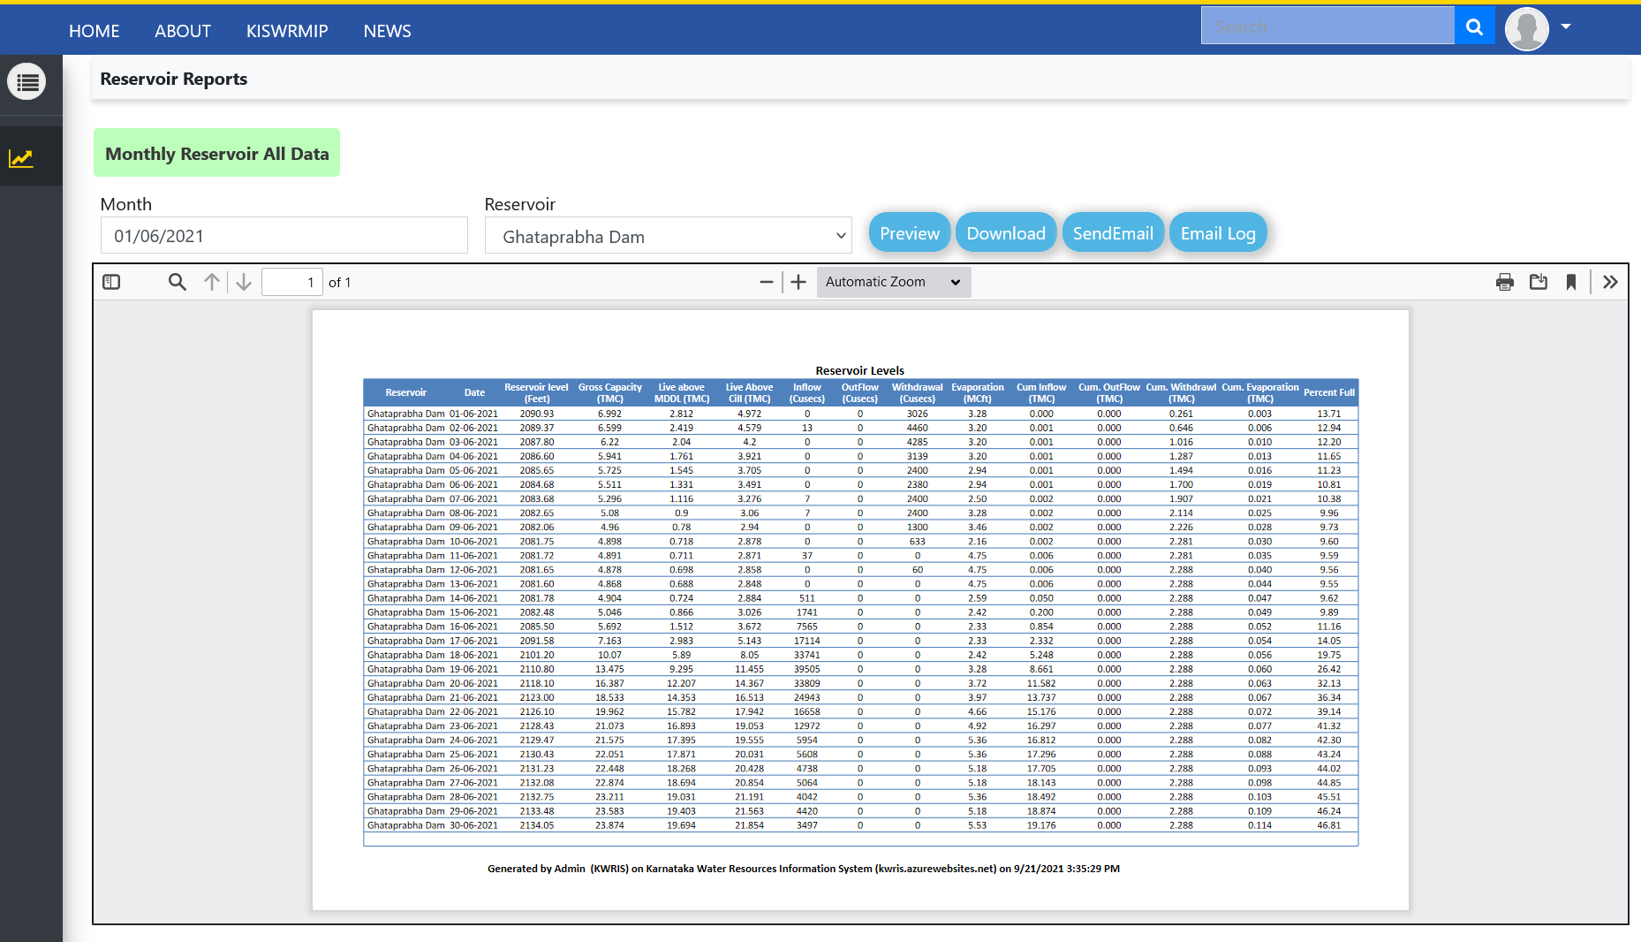

Slide 40
Karnataka Water Resources Information System (KWRIS)
In-Progress
Reservoir Module
Daily levels from 21 Major Reservoirs collected through Mobile app and email
CWMA and CWRC Reports, Cauvery basin daily reservoir info through SMS
Surface Water module
Catchment delineation
Surface water Yield estimation of all sub basins
Groundwater module
Groundwater information Master Database after validation, Well levels
Well profile and Quality parameters
Krishna and Cauvery Basin water level reporting formats
Canal level monitoring
Water bodies surface water extent
Rainfall data integration and Reports
West flowing river data and all reservoir / dam locations and profiles

Slide 41
Karnataka Water Resources Information System (KWRIS)
In-Progress
WUCS / CADA module
Directorate, CADAs, Project level information and individual WUCS
Dashboard and Reports
Remote Sensing
Soil moisture maps
Land and Water Management – CLART, Water Balance
Gram Panchayath Water Balance
Land and Water Management Project output integration
WUCS Services
Water accounting and Water productivity images and maps
High resolution irrigated maps, Stream flow forecasts and Drought forecasts
CLART - Water Harvesting Structures identification tool

Slide 42
Karnataka Water Resources Information System (KWRIS)
In-Progress
Digital Atlas
FAO Aquamaps like framework
Generic Mobile survey, News app
Functional and user interface completed
Testing and User feedback to be done
Database optimization, Data Sharing APIs
Database optimization initiated
Karnataka Water Atlas, K2, K3 and K4 water Atlas integration
User interface, maps optimization
Metadata and APIs

Slide 43

Water Accounting +:
4 sub-basins covered in Karnataka using the Water Accounting Plus (WA+) framework developed by IHE Delft and its partners, FAO and IWMI.
First on pilot basis the Water Accounts were done for Tungabhadra (K-8) sub-basin of Krishna basin
further developed Water Accounts for three river sub-basins in Karnataka – Middle Krishna (K2), Ghataprabha (K3) and Malaprabha (K4) sub-basins all part of the larger Krishna basin in India

Slide 44
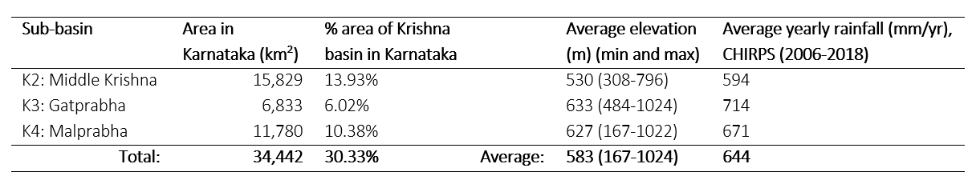
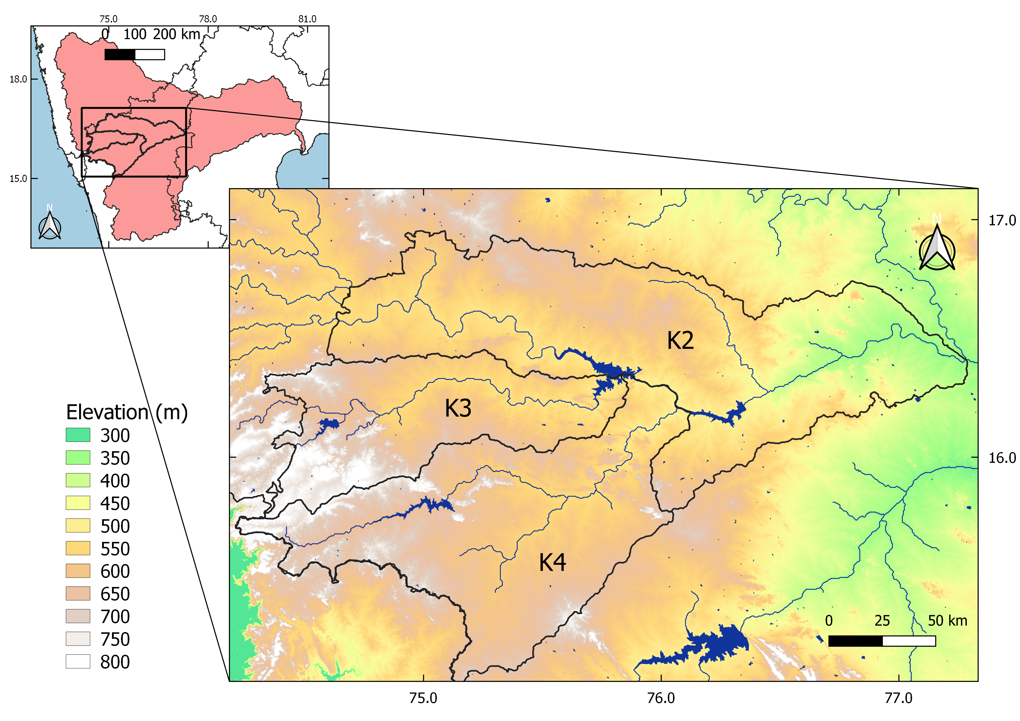
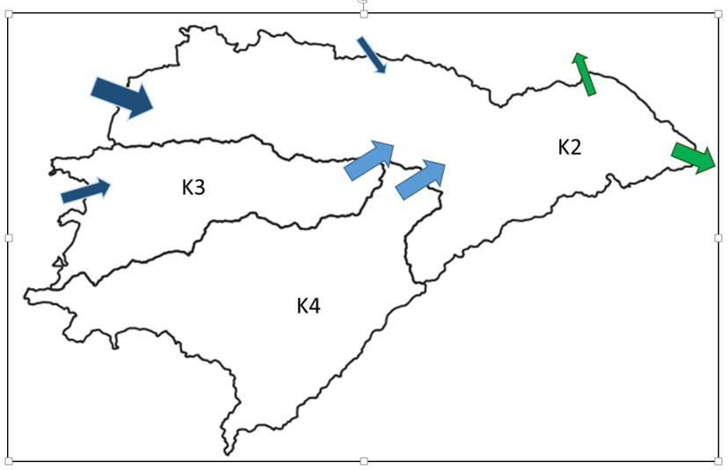
WA+ case study in Karnataka: K2, K3 and K4 basins

Slide 45
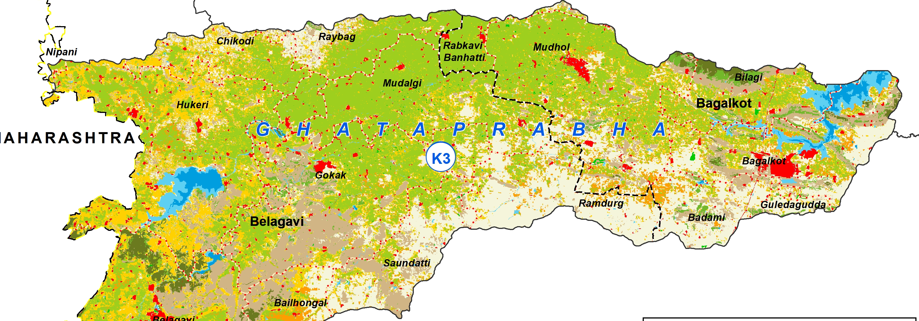
Annual Average Water Balance K3 2010/2011 – 2017/2018
Total ET
4.5 km³/yr
158.92 TMC/yr
K3 6833 km²
P
4.6 km³/yr
162.45 TMC/yr
Rainfall ET
Incremental ET
Inflow
0.6 km³/yr
21.9 TMC/yr
Storage Change
0.5 km³/yr
Outflow
1.2 km³/yr
42.38 TMC/yr
Available 2.1 km³/yr
74.16 TMC/yr
Utilized flow 0.9 km³/yr
31.78 TMC /yr

Slide 46
Impact assessment of NRM measures - MGNREGA Karnataka

Slide 47
Impact assessment of NRM measures - MGNREGA Karnataka

Slide 48
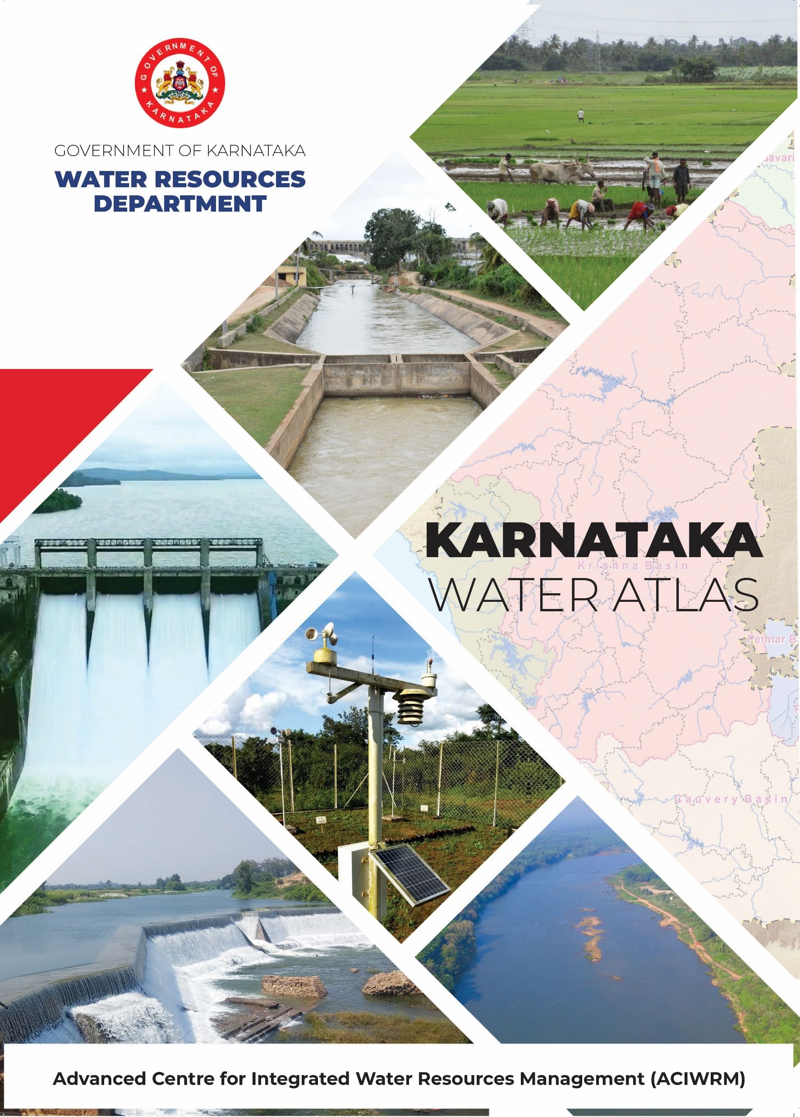
Karnataka Water Atlas and River Basin Atlas
Progress and Plan till Dec 2022
Karnataka Water Atlas & Tungabhadra River Basin Atlas are now made available online at https://aciwrm.karnataka.gov.in/new-page/Atlases/en
Preparation of maps for River Basin Atlas of K2, K3 and K4 sub-basins in progress and will be completed by Dec 2022
Draft of River Basin Atlas of K3 (Ghataprabha) sub-basin completed and discussed with Project Authorities .
Revised draft of River Basin Atlas of K3 (Ghataprabha) sub-basin along with map text to be discussed with stake holders.

Slide 49
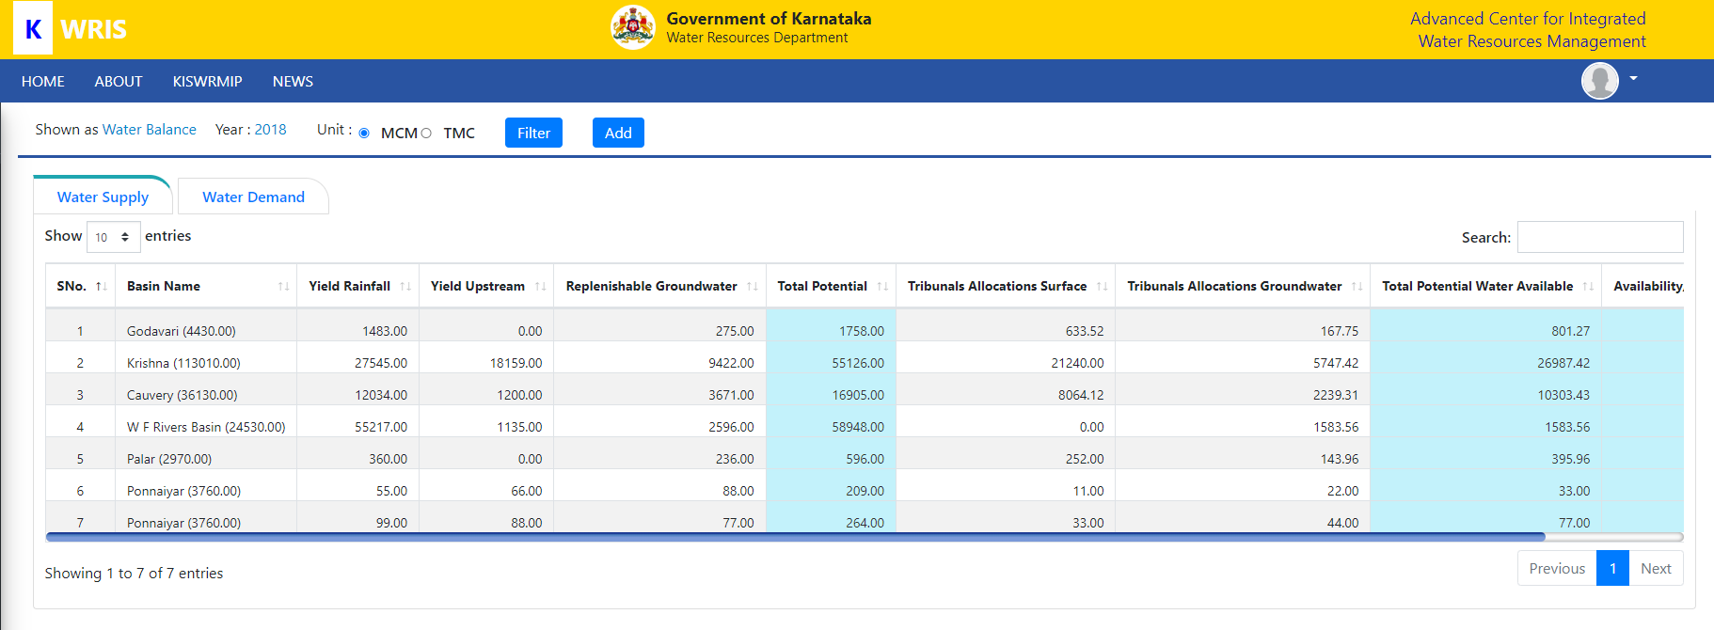
Karnataka Water Balance – Basin wise
Water Resources

Slide 50
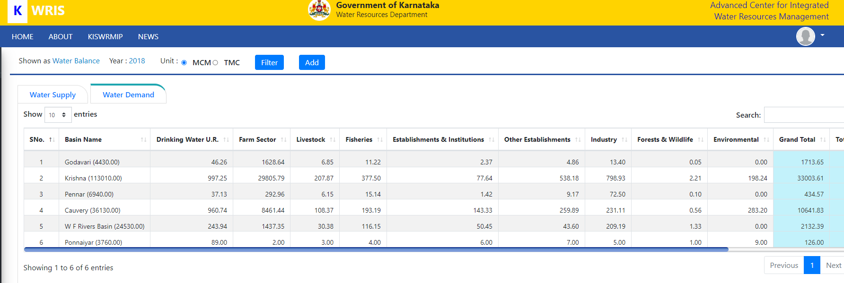
Karnataka Water Balance – Basin wise
Water Demand

Slide 51
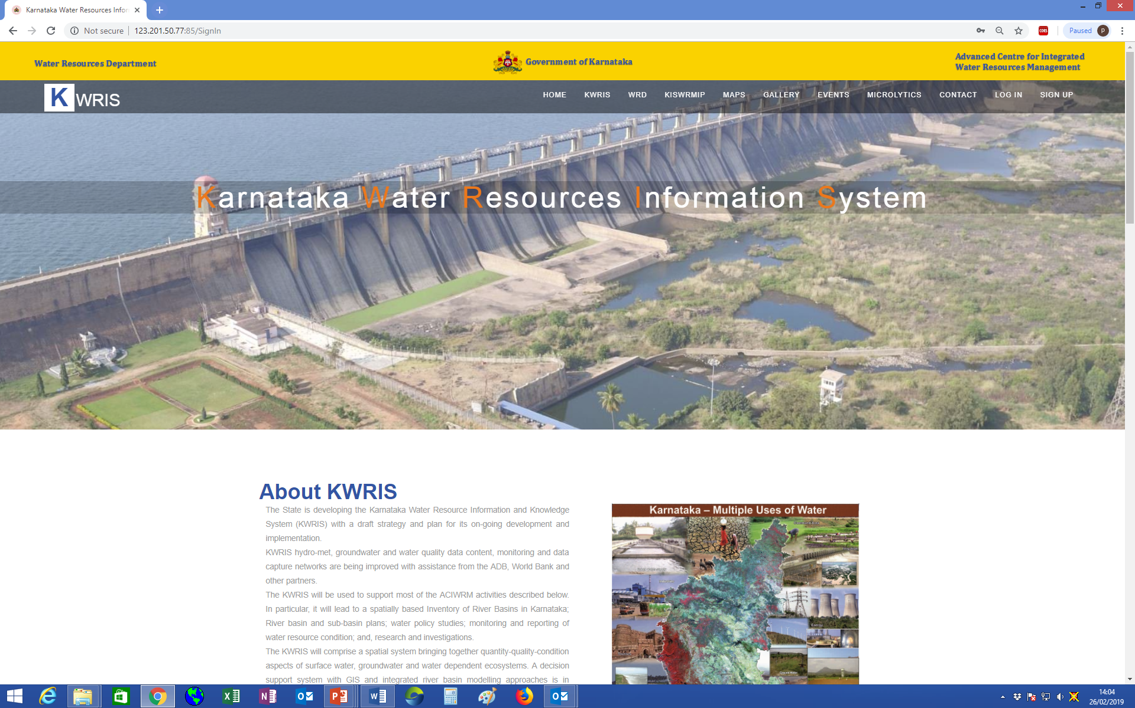
KWRIS LIVE DEMO

Slide 52

Thankyou

